Slide 1
Software Engineering for Internet Applications
Laravel API Development
ADF

Slide 2
Seed some new data
Create a seeder
public function run(){
$faker = Faker::create();
foreach(range(1,30)as $index){
Author::create([
'name' => $faker->name,
'gender'=> 'm',
'birthdate'=> $faker->dateTime(),
'active'=> $faker->boolean(),
]);
}
$authorIds = Author::lists('id')->all();
foreach($authorIds as $authorId){
$author = Author::find($authorId);
$author->address()->create([
'street'=>$faker->address,
'city'=>$faker->city,
]);
}
foreach(range(1,30)as $index){
$authorId = $faker->randomElement($authorIds);
$author = Author::find($authorId);
$book = $author->books()->create([
'title'=>$faker->catchPhrase,
'published'=>$faker->dateTime(),
]);
}
}

Slide 3
Book Resource
Add route resource for book
...
Route::group(['prefix' => 'api/v1'], function() {
Route::resource('authors','AuthorsAPIController');
Route::resource('books','BooksAPIController' );
});
...
\app\Http\routes.php

Slide 4
Create Book Transformer
BookTransformer.php
<?php
namespace App\Acme\Transformers;
class BookTransformer extends Transformer{
public function transform($book){
return [
'book_title' => $book['title'],
'published_at' => $book['published'],
];
}
}
\app\Acme\Transformers\BookTransformer.php

Slide 5
Create Books API Controller
BooksAPIController.php extends API Controller
<?php
namespace App\Http\Controllers;
use App\Book;
use App\Author;
use App\Acme\Transformers\BookTransformer;
class BooksAPIController extends APIController{
protected $bookTransformer;
function __construct(BookTransformer $bookTransformer){
$this->bookTransformer = $bookTransformer;
}
...
}
\app\Http\Controllers\BooksAPIController.php

Slide 6
Create Books API Controller
Add index method and return all Books data
Remember, all is bad
...
public function index(){
$books = Book::all();
return $this->respond([
'data' => $this-> bookTransformer ->transformCollection( $books->all() )
]);
}
...
\app\Http\Controllers\BooksAPIController.php

Slide 7
Create Books API Controller
Add show method
...
public function show($id) {
$books = Book::find($id);
if( ! $books ){
return $this->respondNotFound(‘Book does not exists');
}
return $this->respond([
'data'=>$this-> bookTransformer ->transform($books )
]);
}
...
\app\Http\Controllers\BooksAPIController.php

Slide 8
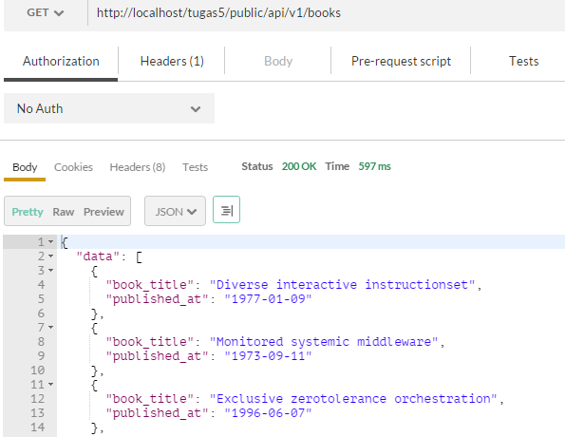
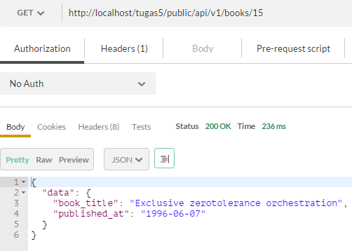
Create Books API Testing
Test the books index method using postman

Slide 9
Nested Resource
Select the books of an author
Add route resource for book
Let’s try to add resource only for index and show methods
...
Route::group(['prefix' => 'api/v1'], function() {
Route::resource('authors','AuthorsAPIController');
Route::resource('books', 'BooksAPIController' );
Route::resource('authors.books', 'BooksAPIController ',
['only' => ['index', 'show']]);
});
...
\app\Http\routes.php

Slide 10
Nested Resource
Modify index method
add $id to find book list from an author with id=$id
...
public function index( $id = null )
{
$books = $id ? Author::findOrFail($id)->books : Book::all();
return $this->respond([
'data' => $this->bookTransformer->transformCollection($books->all())
]);
}
...
\app\Http\Controllers\BooksAPIController.php

Slide 11
Nested Resource
Modify show method
add $id2 to show a book from an author with id=$id2
...
public function show( $id, $id2 = null ) {
$book = $id2 ? Author::findOrFail($id)->books()->find($id2) : Book::find($id);
if( ! $book ){
return $this->respondNotFound('Book does not exists');
}
return $this->respond([
'data'=>$this->bookTransformer->transform($book)
]);
}
...
\app\Http\Controllers\BooksAPIController.php

Slide 12
Nested Resource
Create an error handling if user want to show a book from non existent author
Modify render method at \app\Exceptions\Handler.php
use Response;
...
public function render( $request, Exception $e ) {
if ($e instanceof ModelNotFoundException) {
//$e = new NotFoundHttpException($e->getMessage(), $e);
return Response::json ( [ 'message'=>
[ 'message' => 'Resource not found' ] ], 404 );
}
return parent::render($request, $e);
}
...
\app\Exceptions\Handler.php

Slide 13
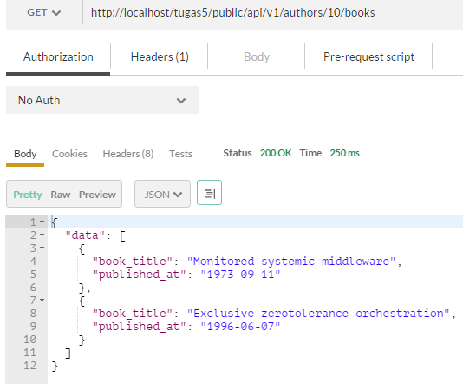
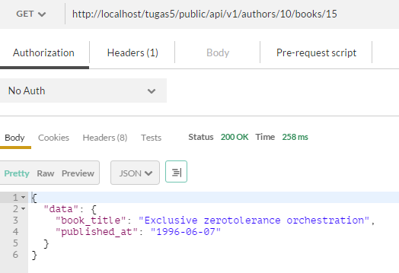
Nested Resource

Slide 14
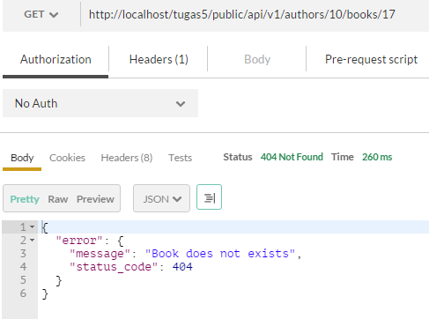
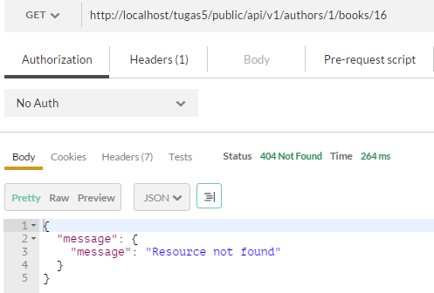
Nested Resource

Slide 15
API Pagination
Remember, Retrieve is bad
Go to Author API Controller
Modify index method, use paginated
Add default limit but also receive if user specify the limit
...
public function index() {
$limit = Input::get('limit') ? :3;
$authors = Author::paginate($limit);
return $this->respond([
'data' => $this->authorTransformer->transformCollection($authors->all())
]);
}
...
\app\Http\Controllers\AuthorsAPIController.php

Slide 16
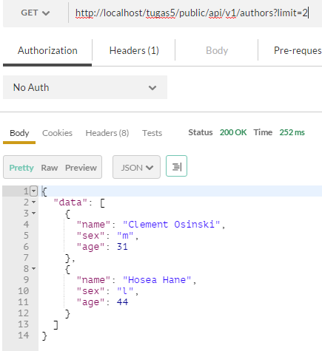
API Pagination

Slide 17
API Pagination
Add paginator object
Total data → total()
Current page → currentPage()
Limit → perPage()
Total page → total() / perPage()
The Link Header Field

Slide 18
API Pagination
Add respond with pagination method in API Controller
...
use Illuminate\Pagination\LengthAwarePaginator as Paginator;
...
protected function respondWithPagination(Paginator $authors, $data){
$data = array_merge($data, [
'paginator' => [
'total_count' => $authors->total(),
'total_pages' => ceil($authors->total() / $authors->perPage()),
'current_pages' => $authors->currentPage(),
'limit' => $authors->perPage(),
]
]);
return $this->respond($data);
}
...
\app\Http\Controllers\APIController.php

Slide 19
API Pagination
Modify the index method to return respond with pagination
...
public function index() {
$limit = Input::get('limit') ? :3;
$authors = Author::paginate($limit);
return $this->respondWithPagination($authors, [
'data'=> $this->authorTransformer->transformCollection($authors->all()),
]);
}
...
\app\Http\Controllers\AuthorsAPIController.php

Slide 20
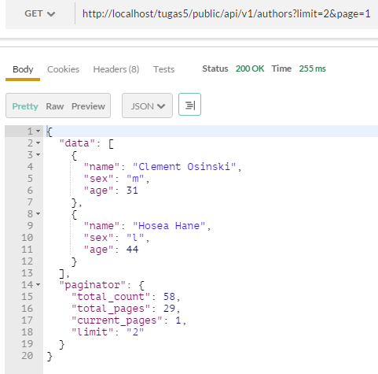
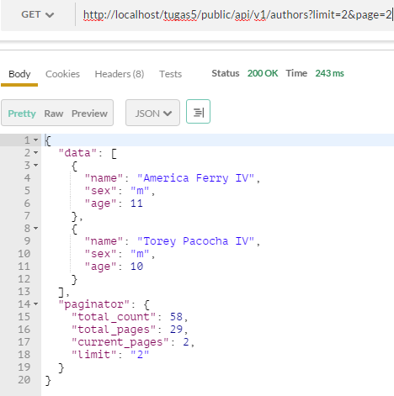
API Pagination

Slide 21
API Testing
Unit Testing
PHPUnit
Codeception
Unit Testing Process
Arrange
Act
Assert

Slide 22
Testing class
Php artisan make:test AuthorTest
Create method to test the API
<?php
use Illuminate\Foundation\Testing\WithoutMiddleware;
use Illuminate\Foundation\Testing\DatabaseMigrations;
use Illuminate\Foundation\Testing\DatabaseTransactions;
class AuthorTest extends TestCase {
/** @test*/
public function it_fetches_authors(){
$this->times(5)->makeAuthor();
$this->getJson('api/v1/authors');
$this->assertResponseOk();
}
}
\tests\AuthorTest.php

Slide 23
Testing class
Create makeAuthor() method to create new Author
Use faker
...
use Faker\Factory as Faker;
use App\Author;
class AuthorTest extends TestCase{
protected $fake;
private function makeAuthor($authorFields = []){
$fake = Faker::create();
$author = array_merge([
'name' => $fake->name,
'gender'=> 'm',
'birthdate'=> $fake->dateTime(),
], $authorFields );
Author::create($author);
}
...
\tests\AuthorTest.php

Slide 24
Testing class
Create getJson() method to retrieve test data
Create setup() method to set up the database
...
public function setUp(){
parent::setUp();
Artisan::call('migrate');
}
private function getJson($uri, $method = 'GET', $param=[] ){
return json_decode($this->call($method, $uri, $param )->getContent());
}
...
\tests\AuthorTest.php

Slide 25
Testing Environment
For testing, let’s not use the real database
Set up sqlite in memory for testing
Add connection sqlite_testing in config\database.php
…
'connections' => [
'sqlite_testing' => [
'driver' => 'sqlite',
'database' => ':memory:',
'prefix' => '',
],
…
\config\database.php

Slide 26
Testing Environment
Add DB_CONNECTION variable in .env file
Remember to remove it when you are not testing it anymore
APP_ENV=local
APP_DEBUG=true
APP_KEY=somerandomkey
DB_CONNECTION=sqlite_testing
…
\.env

Slide 27
Testing the API
Use phpunit from command line

Slide 28
More Testing
Create a new testing method to try to fetch a single author
Check if the author has attribute name, sex, and age
...
/** @test*/
public function it_fetches_a_single_author(){
$this->makeAuthor();
$author = $this->getJson('api/v1/authors/1')->data;
$this->assertResponseOk();
$this->assertObjectHasAttribute('name', $author);
$this->assertObjectHasAttribute('sex', $author);
$this->assertObjectHasAttribute('age', $author);
}
...
\tests\AuthorTest.php

Slide 29
More Testing
Create a new testing method to try to post new author
...
/** @test*/
public function it_creates_a_new_author_given_valid_parameters(){
$fake = Faker::create();
$param = [
'name' => $fake->name,
'gender'=> 'm',
'birthdate'=> $fake->dateTime(),
'active'=> $fake->boolean
];
$this->getJson('api/v1/authors' , 'POST', $param);
$this->assertResponseStatus(201);
}
...
\tests\AuthorTest.php

Slide 30
More Testing
Create a new testing method to try to fetch author that doesn’t exist
Create a new testing method to try to post bad request
...
/** @test*/
public function it_404s_if_an_author_is_not_found(){
$author = $this->getJson('api/v1/authors/x');
$this->assertResponseStatus(404);
}
...
\tests\AuthorTest.php
...
/** @test*/
public function it_402s_if_a_new_author_request_fails_validation(){
$this->getJson('api/v1/authors' , 'POST');
$this->assertResponseStatus(422);
}
...
\tests\AuthorTest.php

Slide 31
Testing the API
Use phpunit from command line

