Slide 1
Software Engineering for Internet Applications
Laravel Framework
ADF

Slide 2
Components
Download all component to use Laravel
Composer
https://getcomposer.org/

Slide 3
Composer
Dependency Manager
Reuse any kind of code
Download popular package
Composer require [vendor name]/[package name]
https://packagist.org/
composer.json
Vendor package
Autolitter

Slide 4
Laravel project
Installing Laravel
Use command prompt
composer create-project laravel/laravel [your-project-name] [--prefer-dist]
Example
composer create-project laravel/laravel project1
View project in public folder
Direct : localhost\project1\public
Server : php –S localhost:port –t public

Slide 5
Why Laravel?
Composer
All in one dependency installer / downloader
Artisan
Php model/script generator
Database Migration and Seeds
Easy to migrate between database
MVC ORM architecture
RESTful Routing
Security

Slide 6
Laravel Routing

Slide 7
Laravel Routing
List all possible url accessed in project
Register all routing in
/app/http/routes.php
Possible routes
Route::get
Route::post
Route::put
Route::delete

Slide 8
Laravel Routing
Routing using direct function or controller function
Function can return text or html/php page to view
Route::get('url', [function view]);
Route::get('url', [controllerClass@functionView]);
Route::get('home', function() {
return 'text';
});
Route::get('home', 'someController@home');

Slide 9
Laravel Routing - Example
…
Route::get('/', 'someController@home');
Route::get(‘contact', 'someController@contact');
…
app/Http/routes.php
class someController extends Controller{
public function home(){
return view('home'); // view page '/resources/views/home.php'
}
public function contact(){ // view text 'contact me'
return 'contact me';
}
}
app/Http/Controllers/someController.php

Slide 10
Laravel Routing - Example
<!DOCTYPE html>
<html>
<head>
<title>This is Home Page</title>
</head>
<body>
<h1>Hello World</h1>
</body>
</html>
resources/views/home.php

Slide 11
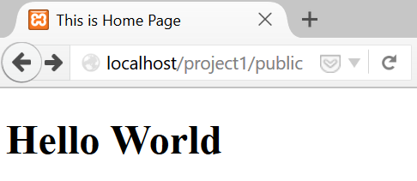
Laravel Routing - Example
localhost/project1/public
localhost/project1/public/contact

Slide 12
Laravel Routing
Register all designed url
example
…
Route::get('/','pagesController@home');
Route::get('contact','pagesController@contact');
Route::get('register','pagesController@register');
Route::get('login','pagesController@login');
Route::get('logout','pagesController@logout');
…
app/Http/routes.php

Slide 13
Laravel View
Html page to view to user
/resources/views
return view file in controller
return view('viewFile')
return view('directory/viewFile')
return view('directory.viewFile')

Slide 14
Artisan Control Utility
Generate a controller page automatically
php artisan make:controller [controllerName] [option]
See: php artisan help make:controller
php artisan make:controller PagesController
Includes default controller method
or
php artisan make:controller PagesController ––plain
Empty controller

Slide 15
Artisan Control Utility
Example :
php artisan make:controller PagesController ––plain
<?php
namespace App\Http\Controllers;
use Illuminate\Http\Request;
use App\Http\Requests;
use App\Http\Controllers\Controller;
class PagesController extends Controller{
//
}
app/Http/Controllers/PagesController.php

Slide 16
Laravel Basic

Slide 17
Display php value
Assume we have a php variable named $variable
To view the value in html views
Escape character format :
{{ $variable }}
Un-escape character format :
{!! $variable !!}

Slide 18
Passing Data to Views Example
…
Route::get('some1','pagesController@somePage1');
…
app/Http/routes.php
escape : {{ $name }} <br>
unescape : {!! $name !!} <br>
resources/views/pages/somePages1.php

Slide 19
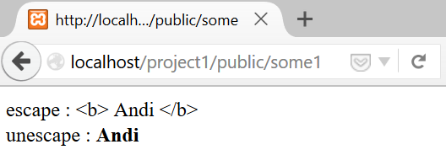
Passing Data to Views Example
class PagesController extends Controller{
public function somePage1(){
$name = '<b> Andi </b>';
return view('pages.somePages1')->with('name', $name);
}
…
}
app/Http/Controllers/pagesController.php
localhost/project1/public/some1

Slide 20
Display php array value
Assume we have a php array named $array
$array = [];
$array['keys1'] = 'value1';
$array['keys2'] = 'value2';
To view the value in html views
Escape character format :
{{ $keys1 }} {{ $keys2 }}

Slide 21
Passing Array to Views Example
…
Route::get('some2','pagesController@somePage2');
…
app/Http/routes.php
escape : <br>
name1 : {{ $name1 }} <br>
name2 : {{ $name2 }} <br>
resources/views/pages/somePages2.php

Slide 22
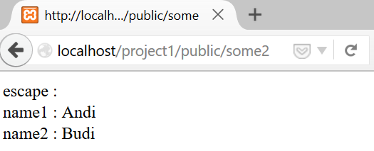
Passing Array to Views Example 1
…
public function somePage2(){
return view('pages.somePages2')->with([
'name1' => 'Andi',
'name2' => 'Budi'
]);
}
…
app/Http/Controllers/pagesController.php
localhost/project1/public/some2

Slide 23
Passing Array to Views Example 2
…
public function somePage2(){
$data = [];
$data['name1'] = 'Andi';
$data['name2'] = 'Budi';
return view('pages.somePages2', $data);
}
…
app/Http/Controllers/pagesController.php
localhost/project1/public/some2

Slide 24
Passing Array to Views Example 3
…
public function somePage2(){
$name1 = 'Andi';
$name2 = 'Budi';
return view('pages.somePages', compact('name1', 'name2'));
}
…
app/Http/Controllers/pagesController.php
localhost/project1/public/some2

Slide 25
PHP code - Blade Template
Instead of using <?php - ?> tag, use '@' to declare the use of php code
@if (condition)
result 1
@elseif (condition)
result 2
@else
result 3
@endif
@for ($i=0;$i<10;$i++)
loop
@endfor
@foreach ($users as $user)
loop {{ $user->attribute }}
@endforeach
@unless(condition)
condition not satisfied
@endunless
@forelse ($users as $user)
loop {{ $user->attribute }}
@empty
No user
@endforelse
@while (condition)
loop
@endwhile

Slide 26
Laravel Blade Template

Slide 27
Layout File – Blade Template
Using basic view means we need to duplicate some codes (style, title, etc) in each view page
Use master file / layout file → laravel blade
Filename.blade.php
Content file can extend the master layout file to add the content

Slide 28
Layout File – Blade Template
'@' keyword
@include('view file')
Show / insert partial view
Master file
@section('layout type') - @show
@yield('layout type ')
Content file
@extends('master layout file')
@section('layout type') - @stop
Override master section with the same layout type

Slide 29
Layout File – Example Master File
<!DOCTYPE html>
<html>
<head>
<title>Document</title>
</head>
<body>
<p> this text is from master </p>
@section('sidebar')
<p>Master Sidebar</p>
@show
<div class="container">
@yield('content')
</div>
</body>
</html>
views/layout.blade.php

Slide 30
Layout File – Example Controller File
…
Route::get('page1','PagesController@page1');
Route::get('page2','PagesController@page2');
…
app/Http/routes.php
…
class PagesController extends Controller{
public function page1(){
$name1 = 'Andi';
return view('pages.page1', compact('name1'));
}
public function page2(){
$name2 = 'Budi';
return view('pages.page2', compact('name2'));
}
…
}
app/Http/Controllers/PagesController.php

Slide 31
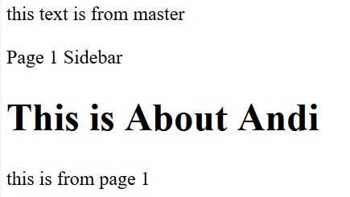
Layout File – Example Content File 1
@extends('layout')
@section('sidebar')
<p>Page 1 Sidebar</p>
@stop
@section('content')
<h1>
This is About {{ $name1 }}
</h1>
<p> this is from page 1 </p>
@stop
views/pages/page1.blade.php

Slide 32
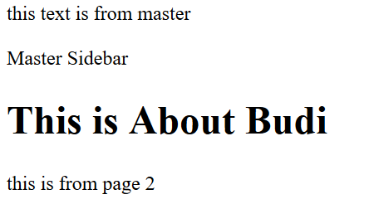
Layout File – Example Content File 2
@extends('layout')
@section('content')
<h1>
This is About {{ $name2 }}
</h1>
<p> this is from page 2 </p>
@stop
views/pages/page2.blade.php

Slide 33
Laravel MVC Design

Slide 34
Model – View – Control
Example
Managing 'student' data
Table Model name
student data ➔ 'students' table
Controller name
student data ➔ 'studentsController.php'
View Resource directory name
/resources/views/students

Slide 35
Model
Use migration and eloquent class
Blueprint model
php artisan make:migration create_students_table --create="students"
File created : database/migrations/create_students_table.php
ORM model
php artisan make:model student
File created : app/student.php
You’ll learn it more at migration database and eloquent part

Slide 36
View
Create view under students directory
(Default naming, case using blade template)
Page to view student list
index.blade.php
Page to view input form student
create.blade.php
Page to show detail of a student data
show.blade.php
Page to edit student data
edit.blade.php

Slide 37
Controller
php artisan make:controller studentsController
(Generated code)
Function index()
Display a listing of the resource
Function create()
Show the form for creating a new resource
Function store(Request $request)
Store a newly created resource in storage

Slide 38
Controller
Function show($id)
Display the specified resource
Function edit($id)
Show the form for editing the specified resource
Function update(Request $request, $id)
Update the specified resource in storage
Function destroy($id)
Remove the specified resource from storage

Slide 39
View – Controller Routing
Page | url | controller
Index page View List of data student | /students | studentsController@index
View Form input data | /students/create | studentsController@create
View detail of selected data | /students/{id} | studentsController@show
View form edit data | /students/{id}/edit | studentsController@edit
Receive and Save post data |  | studentsController@store
Update data |  | studentsController@update
Delete data |  | studentsController@destroy

Slide 40
Routing
Route listing
List all post and get route
Route resource
Simplify all routing in one line
Same as above, as long as the naming is default
Route::get('students', 'studentsController@index');
Route::get('students/create', 'studentsController@create');
Route::post('students', 'studentsController@store');
Route::get('students/{id}', 'studentsController@show');
Route::get('students/{id}/edit', 'studentsController@edit');
Route::put('students/{id}', 'studentsController@update');
Route::patch('students/{id}', 'studentsController@update');
Route::delete('students/{id}', 'studentsController@destroy');
Route::resource('students', 'studentsController');
App/Http/Routes.php

Slide 41
Laravel Database and Migration

Slide 42
Laravel Database
Database configuration
/config/database.php
'default' => 'db_type'
Local development ➔ .env file
DB_HOST
DB_DATABASE
DB_USERNAME
DB_PASSWORD

Slide 43
Laravel Database – Migration
Already included Version control for Database
Resolve consistency issues between developers
Represent instruction toward database in form of php class
Migration class files directory
/database/migrations/

Slide 44
Laravel Database – Migration Class
Create a new migration Class to create new table
php artisan make:migration class_name --create="table_name"
Example
php artisan make:migration create_students_table --create="students"
File created = '[date]_create_students_table.php'

Slide 45
Laravel Database – Migration Class
Automatically generated function script
Up function
Function that called when the migration executed
Default : generate column id and timestamp
Down function
Function that called when we rollback the migration
Default : Drop table
Automatically add the filename with Date created
For version controlling

Slide 46
Laravel Database – Migration Class
Up method
Define the blueprint to create or modify table
Down method
Define the schema to drop or modify table
public function up() {
Schema::create('students', function (Blueprint $table) {
$table->increments('id');
$table->timestamps();
});
}
public function down() {
Schema::drop('students');
}
database/migrations/[date]_create_students_table.php

Slide 47
Laravel Database – Migration Class
Table blueprint
$table->increments('column_name');
$table->string ('column_name');
$table->text ('column_name');
$table->timestamp('column_name')
$table->timestamps()
$table->rememberToken ();
Option
->unique();
->nullable();

Slide 48
Laravel Database – Migration Class
Example students migration class
Table blueprint
…
public function up() {
Schema::create('students', function (Blueprint $table) {
$table->increments('id');
$table->string('name');
$table->string('major');
$table->timestamp('birthdate');
$table->timestamps();
});
}
…
database/migrations/[date]_create_students_table.php

Slide 49
Laravel Database – Run the Migration
Migrate all migration class into database
php artisan migrate
call UP function from all class under migrations directory
Create table as defined in each blueprint
Rollback the last modification in database
Undo 1 last migration
php artisan migrate:rollback
Call DOWN function
Drop table

Slide 50
Laravel Database – Modifying Table
Table is already migrated, and some modification is needed
2 possible conditions :
Project status still in development stage
Database dummy
Project is already at production stage
Real data already inside database

Slide 51
Laravel Database – Modifying Table
Assumed that the project is still in the development stage
Rollback migration
php artisan migrate:rollback
Edit the blueprint
Rename column, Add column, etc.
Re-run the migration
php artisan migrate

Slide 52
Laravel Database – Modifying Table
When it is already in production stage
No rollback is possible anymore
Create a new migration to modify the existing table
php artisan make:migration class_name --table="table_name"
Example
php artisan make:migration add_students_description --table="students"

Slide 53
Laravel Database – Modifying Table
Add blueprint to modify the existing table
…
public function up() {
Schema::table('students', function (Blueprint $table) {
// add new column
$table->text('description')->nullable();
});
}
public function down() {
Schema::table('students', function (Blueprint $table) {
// drop the new column
$table->dropColumn('description');
});
}
…
database/migrations/[date]_add_students_description.php

Slide 54
Laravel Database – Rollback after Modification
Laravel require special package to drop a column
composer require doctrine/dbal
After installing the requirement, then the database can be rolled-back
php artisan migrate:rollback

Slide 55
Laravel Form

Slide 56
Laravel Form
Generate Form
Composer require illuminate/html
Functions that we will use
HTML builder
HTML Service Providers
Form builder
Form Facade

Slide 57
Laravel Form - Setting
Modify file \config\app.php
Add new providers
Add new alias
'providers' => [
...
'Illuminate\Html\HtmlServiceProvider',
...
],
'aliases' => [
...
'Form' => 'Illuminate\Html\FormFacade',
'Html' => 'Illuminate\Html\HtmlFacade',
],

Slide 58
Laravel Form – New Form
Open-close syntax
Form Components
{!! Form::open(['url' => 'target', option]) !!}
Form components
{!! Form::close() !!}
{!! Form::comp_type('comp_name', 'value', [option]) !!}
{!! Form::label('name', 'Name') !!}
{!! Form::text('name') !!}
{!! Form::textarea('name', ['class' => 'class name') !!}
{!! Form::submit('name') !!}

Slide 59
Laravel Form – Student Form
@extends('layout')
@section('content')
{!! Form::open(['url'=>'student', 'class'=>'pure-form']) !!}
<div class="pure-control-group">
{!! Form::label('name','Name') !!}
{!! Form::text('name', null,['placeholder'=>'student name']) !!}
</div>
<div class="pure-control-group">
{!! Form::label('major','Major') !!}
{!! Form::text('major') !!}
</div>
<div class="pure-control-group">
{!! Form::label('description','Description') !!}
{!! Form::textarea('description', null,['rows'=>'4', 'cols'=>'40']) !!}
</div>
<div class="pure-control-group">
{!! Form::label('birthdate','birthdate') !!}
{!! Form::input('date', 'birthdate',date('Y-m-d')) !!}
</div>
<div class="pure-control-group">
{!! Form::submit('Submit',['class'=>'pure-button']) !!}
</div>
{!! Form::close() !!}
@stop
Resources/views/students/create.blade.php

Slide 60
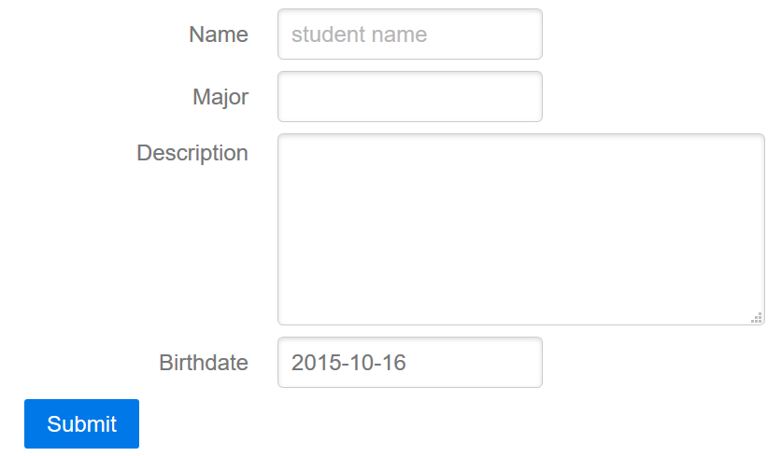
Laravel Form – Student Form
…/public/students/create

Slide 61
Laravel Form – Receive Post Action
Routes.php
Route::post('target', 'controllerClass@method');
Modify controllerClass.php
Change use Illuminate\Http\Request; ➔ use Requests;
Receive post data
$input = Request::all();
$input = Request::get('name');

Slide 62
Laravel Form – Receive Post Action
Add post route
Add function to receive the post data
…
Route::post('students', 'studentsController@store');
…
App/Http/Routes.php
…
use Request; // changed from use Illuminate\Http\Request;
…
public function store(Request $request){
$input = Request::all();
return $input;
}
…
App/Http/Controllers/studentsController.php

Slide 63
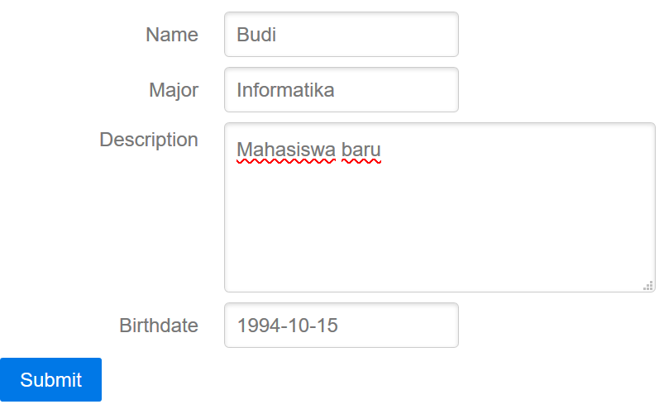
Laravel Form – example
…/public/students/create

Slide 64
Laravel Eloquent ORM

Slide 65
Laravel Eloquent
Laravel Active Record Implementation
Create a Model class for each table
Object Oriented
Persistence Scheme
Class to represent each row from a table
php artisan make:model [options] [--] <name>

Slide 66
Laravel Eloquent
Naming format for Table and Model Class
Users table➔ User class
Cars table ➔ Car class
Students table ➔ Student class
Example
php artisan make:model student
PHP model files
File created : /app/student.php

Slide 67
Laravel Eloquent – save new data
Saving new data to database
Using Store function at controller page
Add use model to controller page
Use App\className;
<?php
namespace App\Http\Controllers;
use App\student;
…
App/Http/Controllers/studentsController.php

Slide 68
Laravel Eloquent – save new data
2 ways to persist data :
One by one initialization
save() method
Mass assignment
::create() method
::firstOrCreate() method
::firstOrNew() method

Slide 69
Laravel Eloquent – save()
One by One Initialization
$data = new \App\class_name;
$data->column_name = 'value';
Etc
Use Request::all() or Request::get('column')

Slide 70
Laravel Eloquent – save()
Use
Or
…
public function store(Request $request){
$student = new \App\student;
$student ->name = Request::get('name');
$student->major = Request::get('major');
$student->description = Request::get('description');
$student->birthdate= Request::get('birthdate');
return $student;
}
…
…
public function store(Request $request){
$input = Request::all();
$student = new \App\student;
$student->name = $input['name'];
$student->major = $input['major'];
$student->description = $input['description'];
$student->birthdate= $input['birthdate'];
return $student;
}
…
App/Http/Controllers/studentsController.php

Slide 71
Laravel Eloquent – save()
Add use App\class_name; to simplify things
…
use App\student;
…
public function store(Request $request){
$input = Request::all();
$student = new student; // no need /App/
$student->name = $input['name'];
$student->major = $input['major'];
$student->description = $input['description'];
$student->birthdate= $input['birthdate'];
return $student;
}
…
App/Http/Controllers/studentsController.php

Slide 72
Laravel Eloquent – save()
Persist Data
save data to database, then redirect back to student page
$data->save();
…
public function store(Request $request){
$input = Request::all();
$student = new student;
$student->name = $input['name'];
$student->major = $input['major'];
$student->description = $input['description'];
$student->birthdate= $input['birthdate'];
$student->save();
return redirect('student');
}
…
App/Http/Controllers/studentsController.php

Slide 73
Laravel Eloquent – ::create()
Use Create Function to initialize the data
\App\class_name::create($array);
or simplify it
…
public function store(Request $request){
$input = Request::all();
student::create($input);
return redirect('student');
}
App/Http/Controllers/studentsController.php
…
public function store(Request $request){
student::create( Request::all() );
return redirect('student');
}
App/Http/Controllers/studentsController.php

Slide 74
Laravel Eloquent – ::create()
By default, Laravel doesn't allow mass assign data
Prevent database injection
Modify model class to allow mass assign data
List Attributes that are allowed to pass through create function under $fillable array
List only attributes that are insensitive to the database
class student extends Model
{
protected $fillable = [
'name', 'major', 'description', 'birthdate'
];
}
App/student.php

Slide 75
Laravel Eloquent ORM – Retrieve

Slide 76
Laravel Eloquent – Retrieve Data
Select all
$data = \App\class_name::all();
Search by Query
$data = \App\class_name::find('id');
$data = \App\class_name::where('column','query')->get();
$data = \App\class_name::where('column','query')->first();

Slide 77
Laravel Eloquent – Retrieve Data
Select sorted
$data = \App\class_name::latest('column')->get();
$data = \App\class_name::oldest('column')->get();
$data = \App\class_name::orderBy('column', 'asc')->get();

Slide 78
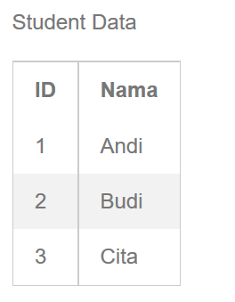
Laravel Eloquent – View Data
…
public function index(){
$students = student::all();
return view('student.index', compact('students'));
}
…
App/Http/Controllers/studentsController.php
@extends('layout')
@section('content')
<h1>This is Result</h1>
<p> Student Data</p>
<table >
<th>ID</th><th>Nama</th>
@foreach ($students as $student)
<tr><td> {{$student ->id}}</td>
<td>{{$student->name}}</td></tr>
@endforeach
</table>
@stop
Resources/views/students/index.blade.php

Slide 79
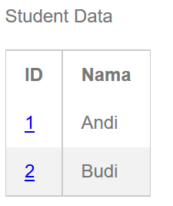
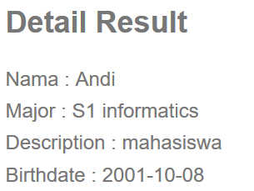
Laravel Eloquent – View Detail Data
Create hyperlink in list data
Open page to view detail data when the link is clicked
…/public/students
…/public/students/1

Slide 80
Laravel Eloquent – View Detail Data
Passing ID of a data to another view
Add hyperlink
@extends('layout')
@section('content')
<h1>This is Result</h1>
<p> Student Data</p>
<table >
<th>ID</th><th>Nama</th>
@foreach ($students as $student)
<tr><td>
<a href="{{ url('/students', $student ->id) }}">{{$student->id }}</td>
<td>{{$student->name}}</td></tr>
@endforeach
</table>
@stop
Resources/views/students/index.blade.php

Slide 81
Laravel Eloquent – View Detail Data
When the link is clicked, the ID will be passed
Add route to receive passed ID
Create find function in show method in studentsController.php to process the request
…
Route::get('students/{id}','studentsController@show');
…
App/Http/Routes.php

Slide 82
Laravel Eloquent – View Detail Data
Use find function
or Use findOrFail function
…
public function show($id){
$student = student::find($id);
if(!$student){ abort(404); }
return view('student.show', compact('student'));
}
…
…
public function show($id){
$student = student::findOrFail($id);
return view('student.show', compact('student'));
}
…
App/Http/Controllers/studentsController.php

Slide 83
Laravel Eloquent – View Detail Data
Create page to show Detail view
@extends('layout')
@section('content')
<h2>Detail Result</h2>
<p>
Nama : {{ $student->name }} <br>
Major : {{ $student->major }} <br>
Description : {{ $student->description }} <br>
Birthdate : {{ $student->birthdate }} <br>
</p>
@stop
…/public/students/1
Resources/views/students/show.blade.php

Slide 84
Laravel Eloquent – Class Mutator
Setter function
Initialize the attribute when the data created
function set[AttributeName]Attribute($data)
Example
Setter attribute major
function setMajorAttribute($data){ … }
Setter attribute name
function setNameAttribute($data){ … }

Slide 85
Laravel Eloquent – Class Mutator
Get class attribute
Use $this->attributes['attribute_name']
Example
Add String 'S1 ' to major attribute
…
public function setMajorAttribute($major){
$this->attributes['major'] = 'S1 '. $major;
}
…
App/student.php

Slide 86
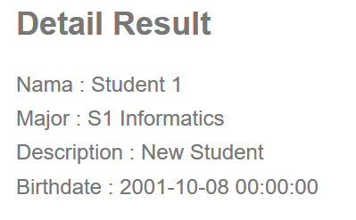
Laravel Eloquent – Class Mutator
…/public/students/create
…/public/students/3

Slide 87
Laravel Eloquent – Class Accessor
Getter function
Retrieve the named attribute using specific manner
function get[AttributeName]Attribute($data)
Example
Getter attribute major
function getMajorAttribute($data){ … }
Getter attribute age
function getNameAttribute($data){ … }

Slide 88
Laravel Eloquent – Class Accessor
Example
Calculate age from birthdate attribute
Update show detail view
use Carbon\Carbon;
…
public function getAgeAttribute(){
$ca = Carbon::parse($this->attributes['birthdate']);
return $ca->diffInYears();
}
…
App/student.php
…
Description : {{ $student->description }} <br>
Birthdate : {{ $student->birthdate }} <br>
Age : {{ $student->age }} <br>
</p>
@stop
Resources/views/students/show.blade.php

Slide 89
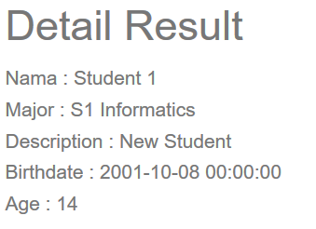
Laravel Eloquent – Class Accessor
…/public/students/create
…/public/students/3

Slide 90
Laravel Eloquent – Query Scope
Easily re-use query logic
Create a scope function to clean the 'where-code'
Example using query
Select only S1 Informatics major students in index
…
public function index(){
$students = student::where('major', 'S1 informatics')->get();
return view('student.index', compact('students'));
}
…
App/Http/Controllers/studentsController.php

Slide 91
Laravel Eloquent – Query Scope
Scope function
Select predefined query
function scope[ScopeName]($query)
Call scope
Call only the scope name
\App\ClassName::ScopeName

Slide 92
Laravel Eloquent – Query Scope
Scope Example
Create scope to select student with S1 Informatics major
…
public function scopeInformaticsMajor($query){
$query->where('major', 'S1 informatics');
}
public function scopeOtherMajor($query){
$query->where('major', '!=', 'S1 informatics');
}
…
App/student.php

Slide 93
Laravel Eloquent – Query Scope
select using scope
View only S1 Informatics major students in index
View other than S1 Informatics major students in index
…
public function index(){
$students = student::informaticsMajor()->get();
return view('student.index', compact('students'));
}
…
App/Http/Controllers/studentsController.php
…
public function index(){
$students = student::otherMajor()->get();
return view('student.index', compact('students'));
}
…
App/Http/Controllers/studentsController.php

Slide 94
Laravel Eloquent – Utilizing Query Scope
…
public function scopeInformaticsMajor($query){
$query->where('major', 'S1 informatics');
}
public function scopeMale($query){
$query->where('gender', 'l');
}
…
App/student.php
…
public function index(){
$students = student::informaticsMajor()-> male()-> orderBy('birthdate')-> get();
return view('student.index', compact('students'));
}
…
App/Http/Controllers/studentsController.php

Slide 95
Laravel Form Validation

Slide 96
Form Request Validation
Laravel-built form validation
Create request class
php artisan make:request <name>
File directory : /app/Http/Requests/
Generated 2 function
authorize() function
Define who is authorized
rules() function
Define the rules

Slide 97
Form Request Validation
Example
php artisan make:request StudentRequest
File created :
/app/Http/Requests/StudentRequest.php
…
public function authorize(){
return false;
}
public function rules(){
return [ // ];
}
…
/app/Http/Requests/StudentRequest.php

Slide 98
Form Request Validation
Authorize function
Define who has the authorization to perform the request
Define return true / false
Return true means anyone can make the request
…
public function authorize(){
return true;
}
…
/app/Http/Requests/StudentRequest.php

Slide 99
Form Request Validation
Rules function
Add term for the request
'attribute' => 'option | option | … '
…
public function rules(){
return [
'name' => 'required | min:3',
'major' => 'required',
'birthdate' => 'required'
];
}
…
/app/Http/Requests/StudentRequest.php

Slide 100
Form Request Validation
Modify store method in studentsController
Add import use StudentRequest
Change Request store to StudentRequest
Get request using $request->all();
…
use App\Http\Requests\StudentRequest;
…
public function store(StudentRequest $request){
student::create( $request -> all() );
return redirect('student');
}
…
App/Http/Controllers/studentsController.php

Slide 101
Validation Routing
Validation passed
yes
no
/students/create
/student
Add show error here

Slide 102
Show Error Validation
Laravel provide $errors variable that store all error message during each operation
Error bag
Messages
Check if there is any error using
@if ( $errors->any() )

Slide 103
Show Error Validation
Add syntax to show $errors data
…
…
<div class="pure-control-group">
{!! Form::submit('Submit',['class'=>'pure-button']) !!}
</div>
{!! Form::close() !!}
@if ( $errors->any() )
<ul class="alert alert-danger">
@foreach ($errors->all() as $error)
<li> {{ $error }} </li>
@endforeach
</ul>
@endif
@stop
Resources/views/students/create.blade.php

Slide 104
Show Error Validation
…/public/students/create

Slide 105
Laravel View Partial

Slide 106
View Partial
Prevent duplicated sections view codes
Break down view into components
Reuse using @include
Clean code

Slide 107
View Partial – Example
@extends('layout')
@section('content')
{!! Form::open(['url'=>'student', 'class'=>'pure-form']) !!}
<div class="pure-control-group">
{!! Form::label('name','Name') !!}
{!! Form::text('name', null,['placeholder'=>'student name']) !!}
</div>
<div class="pure-control-group">
{!! Form::label('major','Major') !!}
{!! Form::text('major') !!}
</div>
<div class="pure-control-group">
{!! Form::label('description','Description') !!}
{!! Form::textarea('description', null,['rows'=>'4', 'cols'=>'40']) !!}
</div>
<div class="pure-control-group">
{!! Form::label('birthdate','birthdate') !!}
{!! Form::input('date', 'birthdate',date('Y-m-d')) !!}
</div>
<div class="pure-control-group">
{!! Form::submit('Submit',['class'=>'pure-button']) !!}
</div>
{!! Form::close() !!}
@if ( $errors->any() )
<ul class="alert alert-danger">
@foreach ($errors->all() as $error)
<li> {{ $error }} </li>
@endforeach
</ul>
@endif
@stop
Form Component
Error Display
Component
Resources/views/students/create.blade.php

Slide 108
View Partial – Example
Partial views
Create ‘partials’ directory inside the view partial
Error views
Use ‘errors’ directory

Slide 109
View Partial – Example
<div class="pure-control-group">
{!! Form::label('name','Name') !!}
{!! Form::text('name', null,['placeholder'=>'student name']) !!}
</div>
<div class="pure-control-group">
{!! Form::label('major','Major') !!}
{!! Form::text('major') !!}
</div>
<div class="pure-control-group">
{!! Form::label('description','Description') !!}
{!! Form::textarea('description', null,['rows'=>'4', 'cols'=>'40']) !!}
</div>
<div class="pure-control-group">
{!! Form::label('birthdate','birthdate') !!}
{!! Form::input('date', 'birthdate',date('Y-m-d')) !!}
</div>
<div class="pure-control-group">
{!! Form::submit('Submit',['class'=>'pure-button']) !!}
</div>
Resources/views/students/partials/form.blade.php
@if ( $errors->any() )
<ul class="alert alert-danger">
@foreach ($errors->all() as $error)
<li> {{ $error }} </li>
@endforeach
</ul>
@endif
Resources/views/errors/form_error.blade.php

Slide 110
View Partial – Example
Clean code using include
@extends('layout')
@section('content')
{!! Form::open(['url'=>'student', 'class'=>'pure-form']) !!}
@include('students.partials.form')
{!! Form::close() !!}
@include('errors.form_error')
@stop
Include Form
Component
Include Error Display
Component
Resources/views/students/create.blade.php

Slide 111
Laravel Eloquent ORM - Update

Slide 112
Laravel Eloquent – Update Data
Suppose we want to edit a value
$data = \App\class_name::find(1);
Edit column value
$data->column = 'new value';
$data->save();
Use update function
$data->update(['column'=>'value]);

Slide 113
Laravel Eloquent – Update Data
Add new routes for updating data
…
Route::get('students/{id}/edit','studentsController@edit');
Route::put('students/{id}', 'studentsController@update');
Route::patch('students/{id}', 'studentsController@update');
…
App/Http/Routes.php

Slide 114
Laravel Eloquent – Update Data
Update Controller
Add edit($id) function
Same as show($id) function, but returns view edit
…
public function edit($id){
$student = student::findOrFail($id);
return view('students.edit', compact('student'));
}
…
App/Http/Controllers/studentsController.php

Slide 115
Laravel Eloquent – Update Data
Update Controller
Add update(Request $request, $id) function
Retrieve the data using find $id
Update the data using update->($request->all())
Get request data using validated Request
…
public function update(StudentRequest $request, $id) {
$student = student::findOrFail($id);
$student->update($request->all());
return redirect('students');
}
…
App/Http/Controllers/studentsController.php

Slide 116
Laravel Eloquent – Update Data
Create edit form using form partial
Form eloquent model binding
Form::model( $data, [‘option’] )
Option = method => PATCH, url => students/id
@extends('layout')
@section('content')
{!! Form::model($student, ['method'=>'PATCH','url'=>'student/'. $student->id]) !!}
@include('students.partials.form')
{!! Form::close() !!}
@include('errors.form_error')
@stop
Resources/views/students/edit.blade.php

Slide 117
Laravel Eloquent – Update Data
Another approach
Target Form Edit using action method from controller
Avoid using hard code url target
@extends('layout')
@section('content')
{!! Form::model($student, ['method'=>'PATCH',
'action'=> ['studentController@update', $student->id]]) !!}
@include('students.partials.form')
{!! Form::close() !!}
@include('errors.form_error')
@stop
Resources/views/students/edit.blade.php

Slide 118
Custom Partial View
Form submit button text
Create page -> ‘Add Student’
Edit Page -> ‘Update Student’
Modify form partial
Set a variable as text for submit button
…
<div class="pure-control-group">
{!! Form::submit($submitText, ['class'=>'pure-button']) !!}
</div>
Resources/views/students/partials/form.blade.php

Slide 119
Custom Partial View
Set the $submitText when calling include view
@extends('layout')
@section('content')
{!! Form::open(['url'=>'student', 'class'=>'pure-form']) !!}
@include('students.partials.form', ['submitText'=>'Add Student'])
{!! Form::close() !!}
…
Resources/views/students/create.blade.php
@extends('layout')
@section('content')
{!! Form::model($student, ['method'=>'PATCH',
'action'=> ['studentController@update', $student->id]]) !!}
@include('students.partials.form', ['submitText'=>'Update Student'])
{!! Form::close() !!}
…
Resources/views/students/edit.blade.php

Slide 120
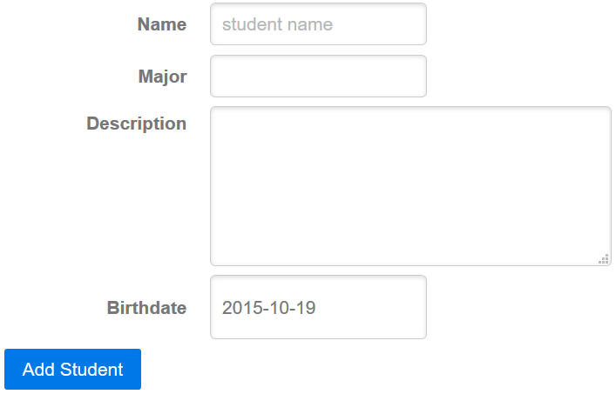
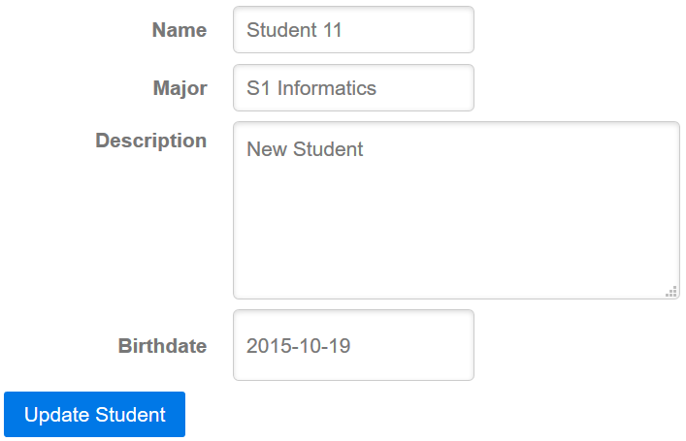
Custom Partial View
…/public/students/3/edit
…/public/students/create

