Slide 1
KUG1C3 Dasar Algoritma dan Pemrograman
Loop

Slide 2
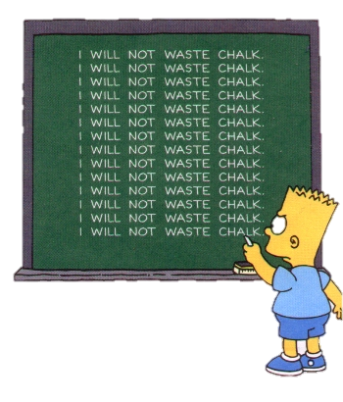
Loop and Repetition
One of the capabilities of computers that can be used is to repeat an instruction, even action, repeatedly with the same performance.
In contrast to humans who tend to make mistakes when doing the same thing (as tired or bored)

Slide 3
Infinite Loop
A loop process must stop at some point
An algorithm that results an infinite loop is wrong
Programmer must be able to detect the occurrence of infinite loop

Slide 4
Parts of Looping
Looping condition
Condition when the repetition must stop
Expressed by a logical expression either explicitly or implicitly
Loop body
Action must be repeated during a specified condition is met for repetition

Slide 5
Initiation and Termination
Repetition structure is usually accompanied by initiation and termination section
initialization,
i.e. the actions taken before the loop was first performed.
termination,
i.e. the actions taken after the repetition done

Slide 6
Looping Notation
There are four kinds of repetition notation:
by stop condition (repeat until)
based on the condition of repetition (while do)
based on the number of repetitions (repeat times)
based enumerator (traversal)

Slide 7
Repeat - Until
Repeat Doing something until I’m satisfied
I want to eat until I explode
Scrub the car until it’s shining sparkly
Doing the programming task until I run out of time
I’ll always love you until death do us part

Slide 8
Loop : Repeat-Until, Iterate-Stop
I want to eat until I can’t eat anymore
Want more?
Start
Eat
No
End
Yes

Slide 9
repeat-until
repeat
action
until (condition)

Slide 10
repeat-until
Program eat_food
Kamus
more: boolean
Algoritma
repeat
output(’eat’)
output(’want more?’)
input(more)
until (more = false)

Slide 11
While - do
As long as I still want to do it, I will continue to do so
While this is still before 5 pm, I’ll continue to sleep
While I’m hungry, I’ll continue to eat
While the sun still rises from the east, I’ll always love you

Slide 12
Loop : While-do
While I’m hungry, I’m gonna eat
Still Hungry?
Start
Yes
Eat
End
No

Slide 13
while-do
while condition do
action

Slide 14
while-do
Program eat_food
Kamus
hungry : boolean
Algoritma
hungry ← true
while hungry do
output(’eat’)
output(still hungry?’)
input(hungry)

Slide 15
Repeat-n-times
Loop within a certain and finite number

Slide 16
Loop : Repeat-n-times
I’m going to eat 5 plates of meatball
Start
i = 1
No
Eat
i = i+1
End
Already 5
plate?
( i > 5 ?)
Yes

Slide 17
repeat-n-times
repeat n times
action

Slide 18
repeat-n-times
Program eat_food
Kamus
Algoritma
repeat 5 times
output(’eat’)

Slide 19
Traversal
Loop using enumeration (increment/decrement)
From Monday to Friday, I got to go to school
Check the attendance of student ID 1103130010 to 1103130040

Slide 20
Loop : Traversal
There’re some plates of food,
I’m going to eat plate number 3 to 9
Start
i = 3
No
Eat
i = i+1
End
i > 9 ?
Yes

Slide 21
Traversal
i traversal [n..m]
action

Slide 22
Traversal
Program eat_food
Kamus
i : integer
Algoritma
i traversal [3..9]
output(’eat’)

Slide 23
Exercise
Read an input number n from user
Write a sequence of 1, 2, 3, … n
Use
Repeat n times
Repeat until
Traversal
While do

Slide 24
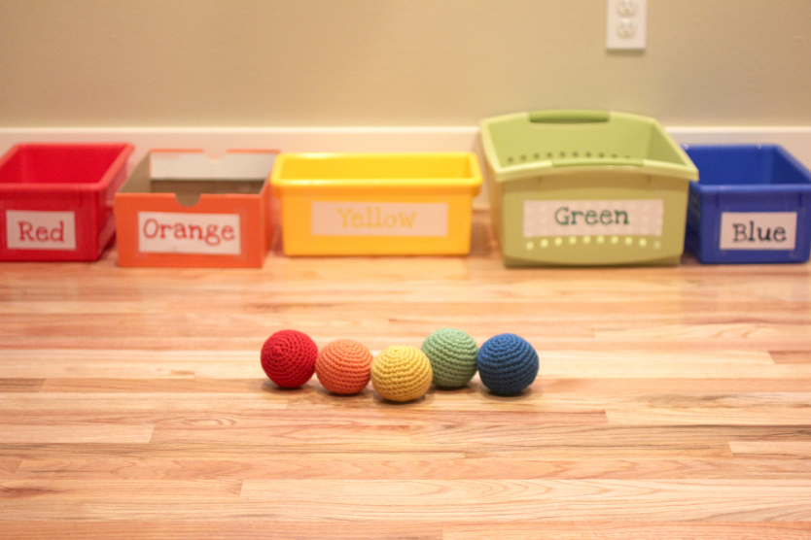
More Exercise
There are several colored balls in a box A.
The number is not known
Make an algorithm to blindly pick any ball and put it into the colored box according to its color until box A empty

