Slide 1
Software Engineering for Internet Applications
AJAX
ADF

Slide 2
Preface - XML
Extensible Markup Language
Extensible
create your own self-descriptive tags, or language, that suits your application.
carries the data, does not present it
store the data irrespective of how it will be presented.
public standard
<message>
<text>Hello, world!</text>
</message>

Slide 3
Preface - XML
<?xml version="1.0" encoding="UTF-8"?>
<student-info>
<!-- Students data -->
<student1>
<name>Budi</name>
<major>Computer Science</major>
<stident-ID>113130001</stident-ID>
</student1>
<student2>
<name>Cita</name>
<major>Computer Science</major>
<stident-ID>113130004</stident-ID>
</student2>
</student-info>

Slide 4
AJAX
Asynchronous JavaScript and XML.
a new technique for creating better, faster, and more interactive web applications with the help of XML, HTML, CSS, and Java Script

Slide 5
Conventional web applications
Synchronous full page refresh
Transmit information to and from the sever using synchronous requests.
It means you fill out a form, hit submit, and get directed to a new page with new information from the server

Slide 6
Using AJAX
Asynchronous partial refresh
When you hit submit, JavaScript will make a request to the server, interpret the results, and update the current screen.
In the purest sense, the user would never know that anything was even transmitted to the server.

Slide 7
AJAX and RIA
AJAX is the most viable Rich Internet Application (RIA) technology so far.
It is getting tremendous industry momentum and several tool kit and frameworks are emerging.
But at the same time, AJAX has browser incompatibility and it is supported by JavaScript, which is hard to maintain and debug

Slide 8
AJAX – Partial Refresh
Web page UI
Your AJAX code
Web server
Click (event)
Action request
Update DOM
Send request to server
User see the action occurs
Server reply with data
Update DOM
User see the action result

Slide 9
AJAX process / operations
Event from client
Create XMLHttpRequest
Send asynchronous request to WebServer
WebServer return XML document result
XMLHttpRequest calls callback() function and processes the result
Update HTML DOM

Slide 10
AJAX process / operations
Example : Load text from a file text and display it on web page
Event from client will occur when the user click the button
<body>
<div id="myDoc"><h2>No document to display... </h2></div>
<button type="button" onclick="loadXMLDoc()">Load Document</button>
</body>

Slide 11
AJAX process / operations
Create js function to send XMLHttpRequest
Send asynchronous request to WebServer
var ajaxRequest;
function loadXMLDoc(){
if (window.XMLHttpRequest) {
// code for IE7+, Firefox, Chrome, Opera, Safari
ajaxRequest=new XMLHttpRequest();
} else {
// code for IE6, IE5
ajaxRequest=new ActiveXObject("Microsoft.XMLHTTP");
}
// Here processRequest() is the callback function.
ajaxRequest.onreadystatechange=processRequest;
ajaxRequest.open("GET", "some document.txt",true);
ajaxRequest.send();
}

Slide 12
AJAX process / operations
WebServer returns XML document result
XMLHttpRequest call callback() function, and
Create js callback function to Update the HTML DOM
function processRequest(){
if (ajaxRequest.readyState==4 && ajaxRequest.status==200){
document.getElementById("myDoc").innerHTML=
ajaxRequest.responseText;
}
}

Slide 13
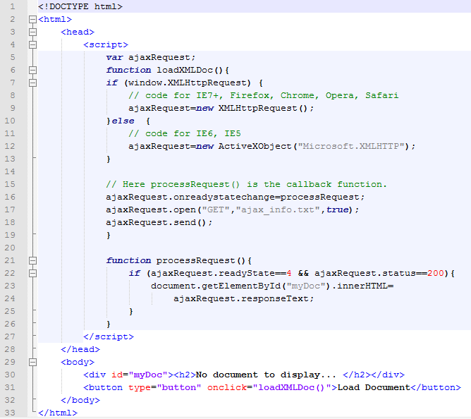
AJAX process / operations (complete script)

Slide 14
AJAX process / operations (complete script)

Slide 15
AJAX Database
Supposed you already have a database with table property of:
tb_Student ( ‘studentID’ varchar(11), 'name' varchar(50), 'sex' varchar(1), ‘score' int(11) )
Create a AJAX operation to access database
Client Side HTML : ajax_result.html
Server Side PHP : ajax_server.php

Slide 16
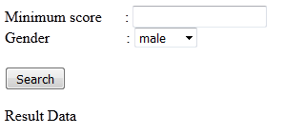
AJAX Database – Client side
Create form to search data
<form name='myForm'>
Minimum score : <input type='text' id='score' /> <br />
Gender :
<select id='sex'>
<option value="m">male</option>
<option value="f">female</option>
</select>
<br />
<input type='button' onclick='ajaxFunction()' value='Query MySQL'/>
</form>

Slide 17
AJAX Database – Client side
Create function script to send XMLHttpRequest
function ajaxFunction(){
if (window.XMLHttpRequest) {
ajaxRequest=new XMLHttpRequest();
}else {
ajaxRequest=new ActiveXObject("Microsoft.XMLHTTP");
}
// Create a function that will receive data
// sent from the server and will update
// div section in the same page.
ajaxRequest.onreadystatechange = processQuery;
// Now get the value from user and pass it to
// server script.
var score = document.getElementById('score').value;
var sex = document.getElementById('sex').value;
var queryString = "?score=" + score + "&sex=" + sex;
ajaxRequest.open("GET", "ajax_server.php" + queryString, true);
ajaxRequest.send(null);
}

Slide 18
AJAX Database – Client side
Create callback function
Create div to display the data
function processQuery(){
if(ajaxRequest.readyState == 4){
var ajaxDisplay = document.getElementById('ajaxDiv');
ajaxDisplay.innerHTML = ajaxRequest.responseText;
}
}
<div id='ajaxDiv'>Result Data</div>

Slide 19
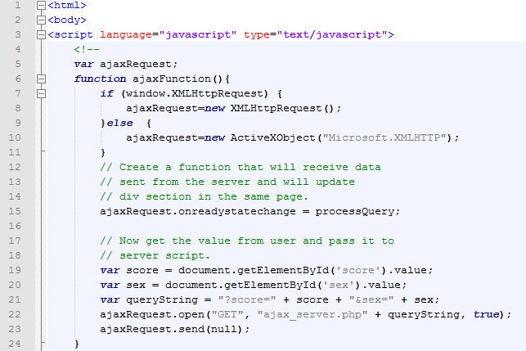
AJAX Database – Client side (complete script)

Slide 20
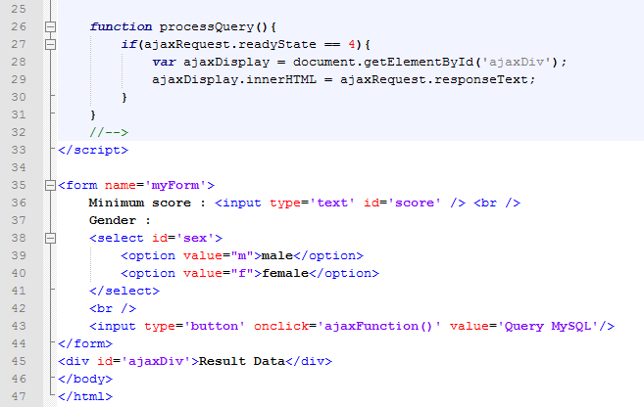
AJAX Database – Client side (complete script)

Slide 21
AJAX Database – Server side
Connect to database
$dbhost = "localhost";
$dbuser = "dbusername";
$dbpass = "dbpassword";
$dbname = "dbname";
//Connect to MySQL Server
mysql_connect($dbhost, $dbuser, $dbpass);
//Select Database
mysql_select_db($dbname) or die(mysql_error());

Slide 22
AJAX Database – Server side
Retrieve data
Build and execute query
// Retrieve data from Query String
$sex = $_GET['sex'];
$score = $_GET['score'];
// Escape User Input to help prevent SQL Injection
$sex = mysql_real_escape_string($sex);
$score = mysql_real_escape_string($score);
//build query
$query = "SELECT * FROM ajax_example WHERE sex = '$sex'";
if(is_numeric($score))
$query .= " AND score >= $score";
//Execute query
$qry_result = mysql_query($query) or die(mysql_error());

Slide 23
AJAX Database – Server side
Build the result string (DOM string update)
//Build Result String
$display_string = "<table>";
$display_string .= "<tr><th>Student ID</th>";
$display_string .= "<th>Name</th>";
$display_string .= "<th>Sex</th>";
$display_string .= "<th>Score</th></tr>";
// Insert a new row in the table for each person returned
while($row = mysql_fetch_array($qry_result)){
$display_string .= "<tr>";
$display_string .= "<td>$row[studentID]</td>";
$display_string .= "<td>$row[name]</td>";
$display_string .= "<td>$row[sex]</td>";
$display_string .= "<td>$row[score]</td>";
$display_string .= "</tr>";
}
$display_string .= "</table>";

Slide 24
AJAX Database – Server side
Display the result
echo "Query: " . $query . "<br />";
echo $display_string;

Slide 25
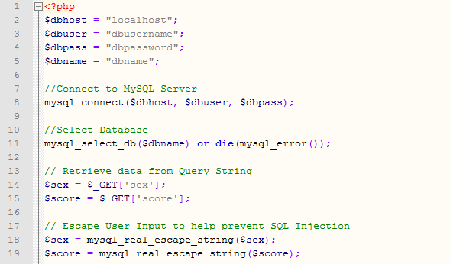
AJAX Database – Server side (complete script)

Slide 26
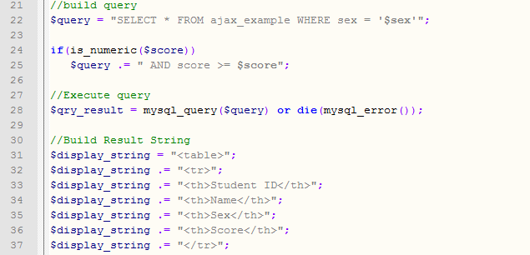
AJAX Database – Server side (complete script)

Slide 27
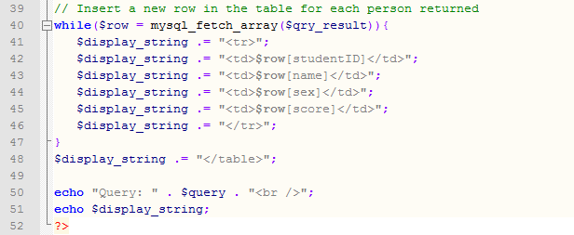
AJAX Database – Server side (complete script)

Slide 28
Question?

