Slide 1
Software Engineering for Internet Applications
Socket Programming
ADF

Slide 2
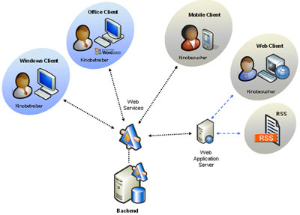
Client-server applications
The server provides some service
processing database queries or sending out current stock prices.
The client uses the service provided by the server
displaying database query results to the user or making stock purchase recommendations to an investor

Slide 3
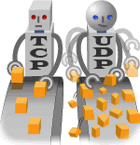
TCP and UDP
Transmission Control Protocol, (TCP)
allows for reliable communication between two applications.
typically used over the Internet Protocol, which is referred to as TCP/IP.
User Datagram Protocol, (UDP)
a connection-less protocol that allows for packets of data to be transmitted between applications.

Slide 4
Socket
one end-point of a two-way communication link between two programs running on the network using TCP.
between a server program and one or more client programs
associates the server program with a specific hardware port on the machine where it runs
any client program anywhere in the network with a socket associated with that same port can communicate with the server program.

Slide 5
Socket
Server program typically provides resources to a network of client programs.
Client programs send requests to the server program, and the server program responds to the request.
When the connection is made, the server creates a socket object on its end of the communication.
The client and server can now communicate by writing to and reading from the socket

Slide 6
Socket Programming using Java
Socket classes are used to represent the connection between a client program and a server program.
The java.net package provides two classes—java.net.Socket and java.net.ServerSocket
implement the client side of the connection and the server side of the connection, respectively

Slide 7
Socket Example using Java
Client Side Socket
Server Side Socket
Single client
Multi client

Slide 8
Client Side socket
Connect to a server
Send message to server
Receive message from server

Slide 9
Server Side Socket
Initialize server
Receive client connection

Slide 10
Server Side Socket
Receive Message from Client
Send Message to Client

Slide 11
How it all fits together
Client (sid)
2037
80
Server (fred)
s = new Socket
(“fred”, 80)
ServerSocket ss.
s = ss.accept()
2037
1583
Socket s
s.getInputStream()
s.getOuputStream()
2037
1583
s.getInputStream()
s.getOuputStream()

Slide 12
Client Side
Client.java

Slide 13
Server Side
Server.java

Slide 14
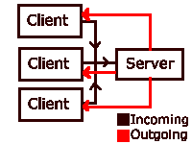
Multi client socket

Slide 15
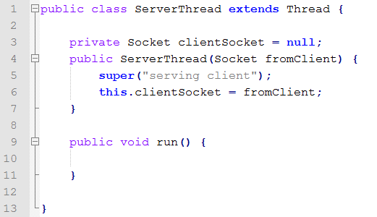
Multi client socket
Use thread in server to accept each new client
ServerThread.java

Slide 16
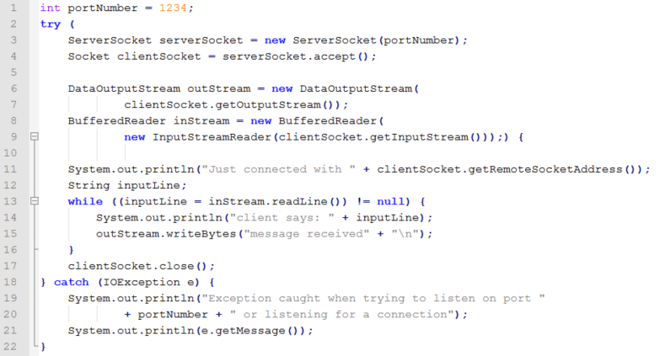
Multi client socket
Modify the server socket
Move this part into ServerThread run() method
Server.java

Slide 17
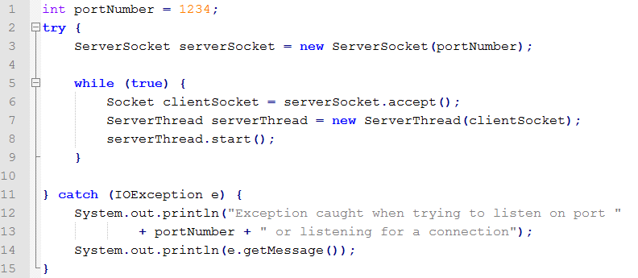
Multi client socket
Create new Thread each time server accept a client
Server.java

Slide 18
Question?

Slide 19
Home Task –
simple Multi-user Chat Application
Server
➔ no change from previous server
ServerThread extends Thread
Client
ReadInput extends Thread
Thread to receive the messages from server
Each user is identified by username
Use hash map table

Slide 20
Server Thread
Create HashMap for user
Constructor

Slide 21
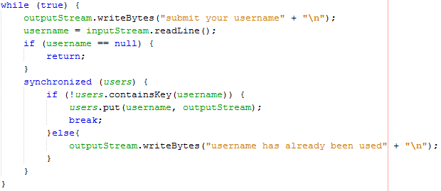
Server Thread
Method run()
Inside block try-catch
Submit username for new user

Slide 22
Server Thread
Receive message from a client
Forward the message to other clients
Chat finished when user type “quit”
Remove the user from hash map

Slide 23
Client
Connect to a server via IP Address
Create Input/output stream

Slide 24
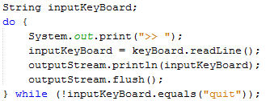
Client
Create thread to listen the message from server
Receive and send user chat until user type “quit”
Close all stream and socket connection

Slide 25
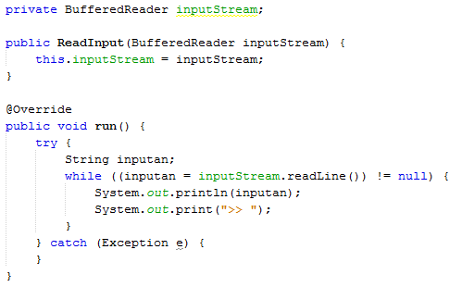
ReadInput
Thread to display the message from server

Slide 26
Finishing
Add some GUI to finalize your app

