Slide 1
Software Engineering for Internet Applications
Laravel Framework
ADF

Slide 2

User Authentication

Slide 3
Basic Authentication
Included in Laravel
  Table Migration
  Model
  Controller
Users table
  \database\migrations\2014_10_12_000000_create_users_table.php
  Id, name, email, password

Slide 4
Basic Authentication
User model
  \app\User.php
Auth Controller
  \app\Http\Controllers\Auth\AuthController.php
  \app\Http\Controllers\Auth\PasswordController.php

Slide 5
Basic Authentication
Basic Authentication View
  \resources\views\auth\login.blade.php
  \resources\views\auth\password.blade.php
  \resources\views\auth\register.blade.php
  \resources\views\auth\reset.blade.php
  \resources\views\app.blade.php
  \resources\views\home.blade.php
Not included in Laravel 5.1
  Included in Laravel 5.0

Slide 6
Basic Authentication – Scafold
Install Scafold Package
  https://github.com/bestmomo/scafold
  composer require bestmomo/scafold dev-master
  composer update
Add the service provider to your config/app.php :
Publish the views and assets :
  php artisan vendor:publish
'providers' => [
...
Bestmomo\Scafold\ScafoldServiceProvider::class,
...
],

Slide 7
Basic Authentication – Scafold
Routes register
…
Route::controllers([
'auth' => 'Auth\AuthController',
'password' =>'Auth\PasswordController',
]);
…
app/Http/routes.php

Slide 8
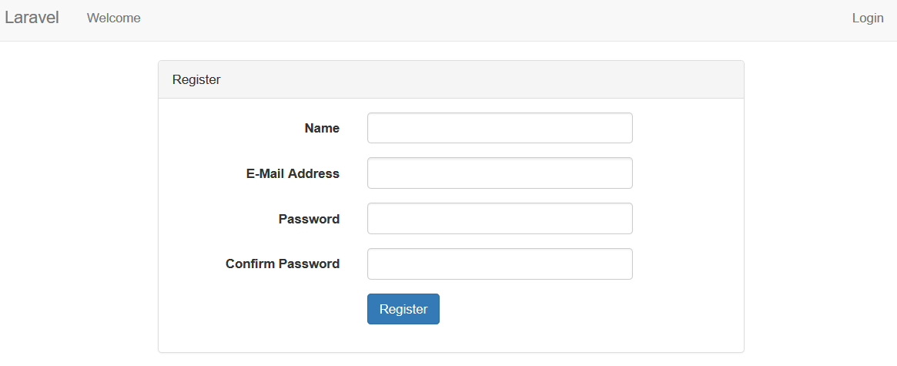
Basic Authentication – Scafold
localhost/project2/public/auth/register

Slide 9
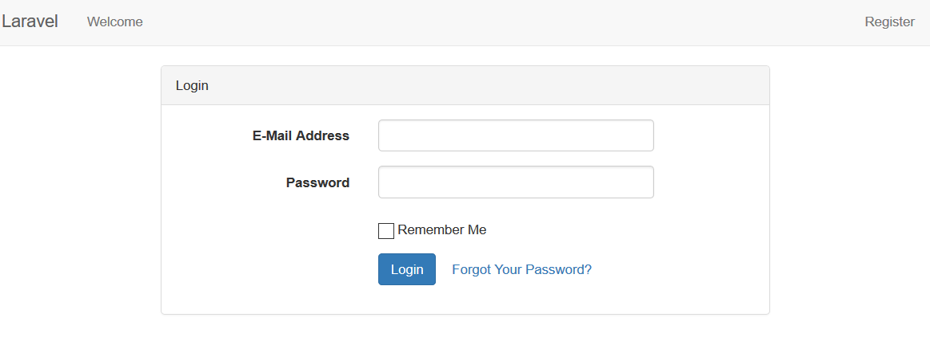
Basic Authentication – Scafold
localhost/project2/public/auth/login

Slide 10
Basic Authentication
Recommended to create your own view
  That's why the basic view is removed in 5.1 update
Custom user Authentication
  Modify User migration
  Modify User model
  Modify AuthController or create new controller

Slide 11
Custom Authentication

Slide 12
Custom Authentication
Example :
  Add birthdate and gender
Modify user migration
…
public function up(){
Schema::create('users', function (Blueprint $table) {
$table->increments('id');
$table->string('name');
$table->string('email')->unique();
$table->string('password', 60);
$table->char('gender', 1);
$table->date('birthdate');
$table->rememberToken();
$table->timestamps();
});
}
…
\database\migrations\2014_10_12_000000_create_users_table.php

Slide 13
Custom Authentication
Modify user model
Modify AuthController
  Modify validator function (if needed)
  Modify create function
…
protected $fillable = ['name', 'email', 'password', 'gender', 'birthdate'];
…
\app\User.php
...
protected function create(array $data){
  return User::create([
  'name' => $data['name'],
  'email' => $data['email'],
  'password' => bcrypt($data['password']),
  'gender' => $data['gender'],
  'birthdate' => $data['bithdate'],
  ]);
}
…
\app\Http\Controllers\Auth\AuthController.php

Slide 14
Custom Authentication
Create form Error view
@if (count($errors) > 0)
<div class="alert alert-danger">
<strong>Whoops!</strong>
There were some problems with your input.<br><br>
<ul>
@foreach ($errors->all() as $error)
<li>{{ $error }}</li>
@endforeach
</ul>
@endif
\resources\views\errors\form_error.blade.php

Slide 15
Custom Authentication
Create form partial for login, register, and reset password
  Input Name → only at register
  Input Email
  Input Password
  Input Confirm Password → at register and reset
  Input Birthdate → only at register
  Redio button Gender → only at register
  Submit Button

Slide 16
Custom Authentication
{!! csrf_field() !!}
@if(Request::is('auth/register'))
<div class="form-group">
{!! Form::label('name', 'Full Name', ['class' => 'col-md-4 control-label']) !!}
<div class="col-md-6">
{!! Form::text('name', null, ['value'=>'{{ old("name") }}', 'class'=>'form-control']) !!}
</div>
</div>
@endif
<div class="form-group">
{!! Form::label('email', 'E-Mail Address', ['class' => 'col-md-4 control-label']) !!}
<div class="col-md-6">
{!! Form::email('email', null, ['value'=>'{{ old("email") }}', 'class'=>'form-control']) !!}
</div>
</div>
…
\resources\views\auth\form.blade.php

Slide 17
Custom Authentication
…
@if(!Request::is('password/email'))
<div class="form-group">
{!! Form::label('password', 'Password', ['class' => 'col-md-4 control-label']) !!}
<div class="col-md-6">
{!! Form::password('password', ['class' => 'form-control']) !!}
</div>
</div>
@endif
@if(Request::is('auth/register') || Request::is('password/reset'))
<div class="form-group">
{!! Form::label('password_confirmation', 'Confirm Password', ['class' => 'col-md-4 control-label']) !!}
<div class="col-md-6">
{!! Form::password('password_confirmation', ['class'=>'form-control']) !!}
</div>
</div>
@endif
…
\resources\views\auth\form.blade.php

Slide 18
Custom Authentication
…
@if(Request::is('auth/register'))
<div class="form-group">
{!! Form::label('birthdate', 'Birthdate', ['class' => 'col-md-4 control-label']) !!}
<div class="col-md-6">
{!! Form::input('date', 'birthdate', date('Y-m-d'), ['class'=>'form-control']) !!}
</div>
</div>
<div class="form-group">
{!! Form::label('gender', 'Gender', ['class' => 'col-md-4 control-label']) !!}
<div class="col-md-6">
<div class="radio">
<label>{!! Form::radio('gender', 'm' ) !!} Male</label>
<label>{!! Form::radio('gender', 'l' ) !!} Female</label>
</div>
</div>
</div>
@endif
<div class="form-group">
<div class="col-md-6 col-md-offset-4">
{!! Form::submit($submitText, ['class'=>'btn btn-primary']) !!}
</div>
</div>
\resources\views\auth\form.blade.php

Slide 19
Custom Authentication
Create login page
Create register page
@extends('app')
@section('content')
<div class="panel-heading">Login</div>
<div class="panel-body">
@include('errors.form_error')
{!! Form::open(['url'=>'/auth/login', 'class'=>'form-horizontal']) !!}
@include('auth.form', ['submitText'=>'Login'])
{!! Form::close() !!}
</div>
@endsection
\resources\views\auth\login.blade.php
@extends('app')
@section('content')
<div class="panel-heading">Register</div>
<div class="panel-body">
@include('errors.form_error')
{!! Form::open(['url'=>'/auth/register', 'class'=>'form-horizontal']) !!}
@include('auth.form', ['submitText'=>'Register'])
{!! Form::close() !!}
</div>
@endsection
\resources\views\auth\register.blade.php

Slide 20
Custom Authentication
Create home page
@extends('app')
@section('content')
<div class="container">
<div class="row">
<div class="col-md-10 col-md-offset-1">
<div class="panel panel-default">
<div class="panel-heading">Home</div>
<div class="panel-body">
Welcome
@if(!auth()->guest())
You are logged in! {!! \Auth::user()->name !!}
@endif
</div>
</div>
</div>
</div>
</div>
@endsection
\resources\views\pages\home.blade.php

Slide 21
Custom Authentication
Create page Controller
namespace App\Http\Controllers;
use Illuminate\Http\Request;
use App\Http\Requests;
use App\Http\Controllers\Controller;
class PagesController extends Controller{
public function index() {
return view('pages.home');
}
}
\app\Http\Controllers\PagesController.php

Slide 22
Custom Authentication
Register home route
Route::get('/', 'PagesController@index');
Route::get('home', 'PagesController@index');
Route::controllers([
'auth' => 'Auth\AuthController',
'password' =>'Auth\PasswordController',
]);
\app\Http\routes.php

Slide 23
Custom Authentication
Create master/layout file
<!DOCTYPE html>
<html lang="en">
<head>
<meta charset="utf-8">
<meta http-equiv="X-UA-Compatible" content="IE=edge">
<meta name="viewport" content="width=device-width, initial-scale=1">
<title>Project 2</title>
<link href="https://maxcdn.bootstrapcdn.com/bootstrap/3.3.5/css/bootstrap.min.css" rel="stylesheet">
</head>
<body>
<nav class="navbar navbar-default">
<div class="container-fluid">
<div class="navbar-header">
<button type="button" class="navbar-toggle collapsed" data-toggle="collapse" data-target="#navbar">
<span class="sr-only">Toggle Navigation</span>
<span class="icon-bar"></span>
<span class="icon-bar"></span>
<span class="icon-bar"></span>
</button>
<a class="navbar-brand" href="#">Laravel</a>
</div>
…
\resources\views\app.blade.php

Slide 24
Custom Authentication
Create master/layout file
…
<div class="collapse navbar-collapse" id="navbar">
@include('pages.nav')
</div>
</div>
</nav>
@yield('content')
<!-- Scripts -->
<script src="//cdnjs.cloudflare.com/ajax/libs/jquery/2.1.3/jquery.min.js"></script>
<script src="//cdnjs.cloudflare.com/ajax/libs/twitter-bootstrap/3.3.5/js/bootstrap.min.js"></script>
</body>
</html>
\resources\views\app.blade.php

Slide 25
Custom Authentication
Create navigation/menu page
Main Menu
  Home
Side Menu
  If page is not login page ➔ Login
  If page is not register page ➔ Register
  If user is login ➔ Logout

Slide 26
Custom Authentication
Create navigation/menu page
<ul class="nav navbar-nav">
<li><a href="{{ url('/') }}">Home</a></li>
</ul>
<ul class="nav navbar-nav navbar-right">
@if(auth()->guest())
@if(!Request::is('auth/login'))
<li><a href="{{ url('/auth/login') }}">Login</a></li>
@endif
@if(!Request::is('auth/register'))
<li><a href="{{ url('/auth/register') }}">Register</a></li>
@endif
@else
<li class="dropdown">
<a href="#" class="dropdown-toggle" data-toggle="dropdown" role="button"
aria-expanded="false">{{ auth()->user()->name }} <span class="caret"></span></a>
<ul class="dropdown-menu" role="menu">
<li><a href="{{ url('/auth/logout') }}">Logout</a></li>
</ul>
</li>
@endif
</ul>
\resources\views\pages\nav.blade.php

Slide 27
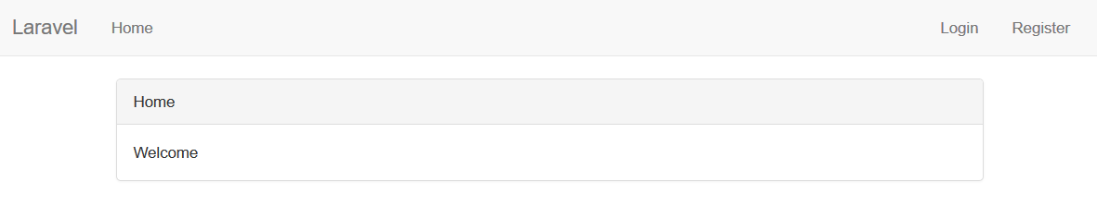
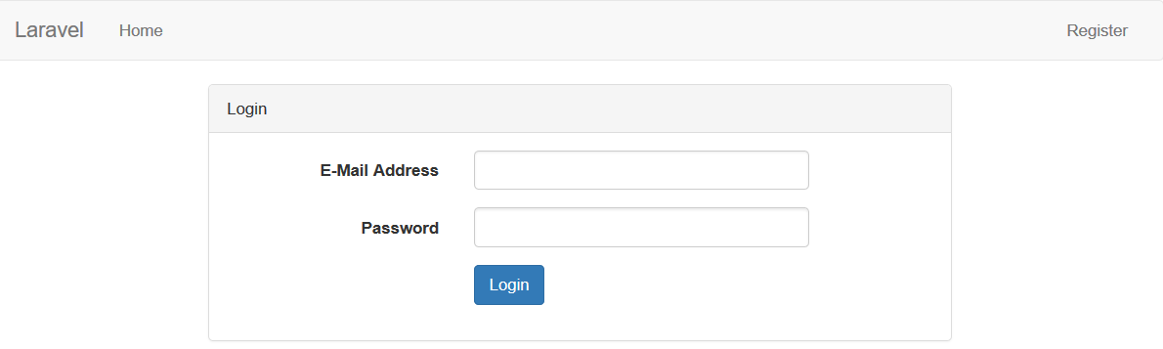
Custom Authentication
project2/public/home not logged in
project2/public/auth/login

Slide 28
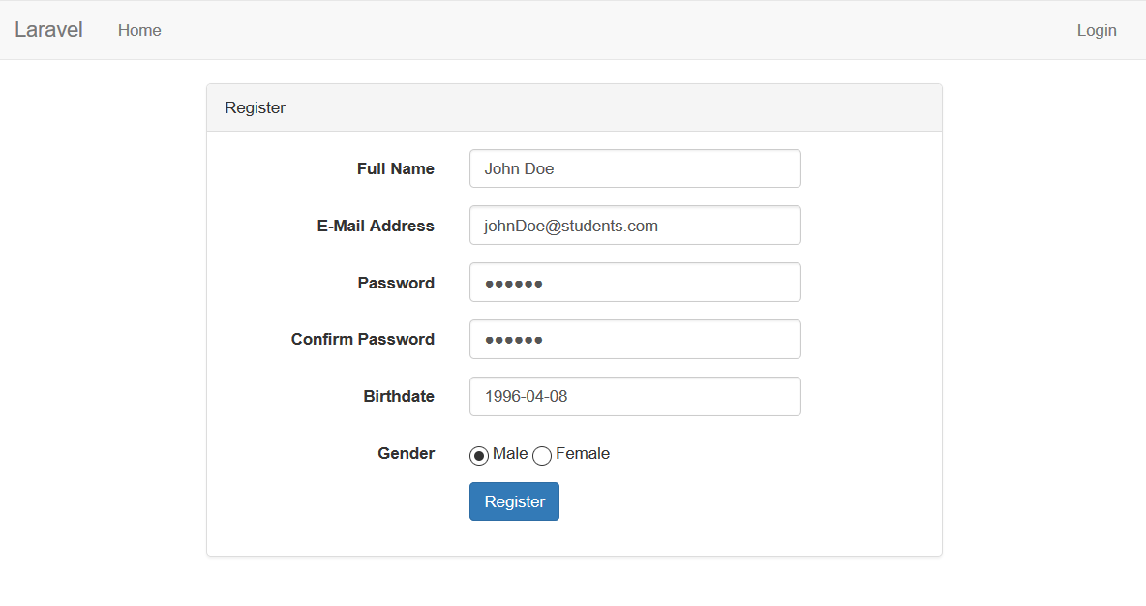
Custom Authentication
project2/public/auth/register

Slide 29
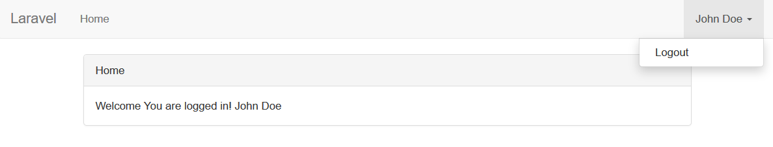
Custom Authentication
project2/public/home logged in

Slide 30
HTTP Middleware

Slide 31
HTTP Middleware
mechanism for filtering HTTP requests
includes a middleware that verifies if the user is authenticated
  If the user is not authenticated, the middleware will redirect the user to the login screen
Create new middleware
  php artisan make:middleware <NameMiddleware>
Directory
  app/Http/Middleware

Slide 32
HTTP Middleware
Registering Middleware
  \app\Http\Kernel.php
  Global → $middleware
  Route → $routeMiddleware
Assigning Middleware To Routes
  Via routes.php
  Via Controller

Slide 33
Middleware Example
Data management, example : book author
No authorization required
  Index
  Show
Authorization required
  Create
  Edit
  Delete

Slide 34
Authors Migration Table
Create table 'authors'
  php artisan make:migration create_authors_table
  Id, name, gender, birthdate
…
public function up() {
Schema::create('authors', function (Blueprint $table) {
$table->increments('id');
$table->string('name');
$table->char('gender',1);
$table->date('birthdate');
$table->timestamps();
});
}
…
\database\migrations\[date]_create_authors_table.php

Slide 35
Author Model Class
Craete Author model
  php artisan make:model Author
  List $fillable for mass assign
  Add an Accessor to calculate the age
namespace App;
use Carbon\Carbon;
use Illuminate\Database\Eloquent\Model;
class Author extends Model{
protected $fillable = ['name', 'gender', 'birthdate'];
  public function getAgeAttribute(){
$ca = Carbon::parse($this->attributes['birthdate']);
return $ca->diffInYears();
}
}
\app\Author.php

Slide 36
Author Validation
Create Author Request Validation
  php artisan make:request AuthorRequest
Check if the user is logged in or not
Unauthorized user won't be able to inject a request data
…
public function authorize(){
return auth()->check();
}
…
\app\Http\Requests\AuthorRequest.php

Slide 37
Author Validation
Add validation for each member
…
public function authorize(){
return auth()->check();
}
public function rules(){
return [
'name' => 'required | min:3',
'gender' => 'required',
'birthdate' => 'required'
];
}
…
\app\Http\Requests\AuthorRequest.php

Slide 38
Authors Views
Create resource directory
  \resources\views\authors
    create.blade.php
    edit.blade.php
    form.blade.php
    index.blade.php
    show.blade.php

Slide 39
Authors Views – Form Partial
  {!! csrf_field() !!}
  <div class="form-group">
  {!! Form::label('name', 'Full Name', ['class' => 'col-md-4 control-label']) !!}
  <div class="col-md-6">
  {!! Form::text('name', null, ['value'=>'{{ old("name") }}', 'class'=>'form-control']) !!}
  </div>
  </div>
  <div class="form-group">
  {!! Form::label('birthdate', 'Birthdate', ['class' => 'col-md-4 control-label']) !!}
  <div class="col-md-6">
  {!! Form::input('date', 'birthdate', date('Y-m-d'), ['class'=>'form-control']) !!}
  </div>
  </div>
  <div class="form-group">
  {!! Form::label('gender', 'Gender', ['class' => 'col-md-4 control-label']) !!}
  <div class="col-md-6"><div class="radio">
  <label>{!! Form::radio('gender', 'm' ) !!} Male</label>
  <label>{!! Form::radio('gender', 'l' ) !!} Female</label>
  </div></div>
  </div>
  <div class="form-group">
  <div class="col-md-6 col-md-offset-4">
  {!! Form::submit($submitText, ['class'=>'btn btn-primary']) !!}
  </div>
  </div>
\resources\views\authors\form.blade.php

Slide 40
Authors Views – index page
@extends('app')
@section('content')
<div class="col-md-8 col-md-offset-2">
<div class="panel panel-default">
<div class="panel-heading">Author Data</div>
<div class="panel-body">
<table class="table table-bordered" >
@foreach ($authors as $author)
<tr><td>{{ $author->name }}</td>
<td><a class="btn btn-primary" href="{{ url('/authors', $author->id) }}" >
Show Data</a></td>
<td><a class="btn btn-primary" href="{{ url('/authors/'. $author->id . '/edit') }}" >
Edit Data</a></td>
<td>{!! Form::open(array('url' => 'authors/' . $author->id)) !!}
{!! Form::hidden('_method', 'DELETE') !!}
{!! Form::submit('Delete Data', array('class' => 'btn btn-warning')) !!}
{!! Form::close() !!}
</td> </tr>
@endforeach
</table>
</div>
</div>
</div>
@endsection
\resources\views\authors\index.blade.php

Slide 41
Authors Views – create page
@extends('app')
@section('content')
<div class="col-md-8 col-md-offset-2">
<div class="panel panel-default">
<div class="panel-heading">Add New Author</div>
<div class="panel-body">
@include('errors.form_error')
{!! Form::open(['url'=>'authors', 'class'=>'form-horizontal']) !!}
@include('authors.form', ['submitText'=>'Add Author'])
{!! Form::close() !!}
</div>
</div>
</div>
@endsection
\resources\views\authors\create.blade.php

Slide 42
Authors Views – edit page
@extends('app')
@section('content')
<div class="col-md-8 col-md-offset-2">
<div class="panel panel-default">
<div class="panel-heading">Edit Author Data</div>
<div class="panel-body">
@include('errors.form_error')
{!! Form::model($author, ['method'=>'PATCH',
'action'=> ['AuthorsController@update', $author->id],
'class'=>'form-horizontal']) !!}
@include('authors.form', ['submitText'=>'Update Author'])
{!! Form::close() !!}
</div>
</div>
</div>
@endsection
\resources\views\authors\edit.blade.php

Slide 43
Authors Views – show page
@extends('app')
@section('content')
<div class="col-md-8 col-md-offset-2">
<div class="panel panel-default">
<div class="panel-heading">Detail Author Data</div>
<div class="panel-body">
Nama : {{ $author->name }} <br>
Gender : @if ($author->gender == 'm' ) Male @else Female @endif <br>
Birthdate : {{ $author->birthdate }} <br>
Age : {{ $author->age }} <br>
</div>
<div class="panel-body">
<table class="table" ><tr>
<td><a class="btn btn-primary" href="{{ url('/authors/'. $author->id . '/edit') }}" >
Edit Data</a></td>
<td>{!! Form::open(array('url' => 'authors/' . $author->id)) !!}
{!! Form::hidden('_method', 'DELETE') !!}
{!! Form::submit('Delete Data', array('class' => 'btn btn-warning')) !!}
{!! Form::close() !!}
</td></tr></table>
</div>
</div>
</div>
@endsection
\resources\views\authors\show.blade.php

Slide 44
Author Controller
php artisan make:controller AuthorsController
…
use App\Author;
use App\Http\Requests\AuthorRequest;
…
class AuthorsController extends Controller{
…
public function index(){
$authors = author::all();
return view('authors.index', compact('authors'));
}
public function create(){
return view('authors.create');
}
…
\app\Http\Controllers\AuthorsController.php

Slide 45
Author Controller
…
public function store(AuthorRequest $request){
author::create( $request->all());
return redirect('authors');
}
public function show($id){
$author = author::findOrFail($id);
return view('authors.show', compact('author'));
}
public function edit($id){
$author = author::findOrFail($id);
return view('authors.edit', compact('author'));
}
…
\app\Http\Controllers\AuthorsController.php

Slide 46
Author Controller
…
public function update(AuthorRequest $request, $id){
$author = author::findOrFail($id);
$author->update($request->all());
return redirect('authors');
}
public function destroy($id){
$author = author::findOrFail($id);
$author->delete();
return redirect('authors');
}
}
\app\Http\Controllers\AuthorsController.php

Slide 47
Middleware Example
Bind middleware authorization to AuthorsController
Create constructor
  $this->middleware('auth');
    To access All function, user must login first
  $this->middleware('auth', ['only' => 'function_name']);
    Bind middleware authorization to specific functions
  $this->middleware('auth', ['except' => 'function_name']);
    Bind middleware authorization to all function except specific functions

Slide 48
Middleware Example
Bind middleware only to create function
Means that any user can view but only logged in user can create, edit, and delete data
  When user try to access page create, page edit, or delete a data, they will be redirected to login page
…
public function __construct(){
$this->middleware('auth', ['only' => ['create', 'edit', 'destroy']]);
}
…
\app\Http\Controllers\AuthorsController.php

Slide 49
Middleware Example
Register home route
Route::get('/', 'PagesController@index');
Route::get('home', 'PagesController@index');
Route::resource('authors','AuthorsController');
Route::controllers([
'auth' => 'Auth\AuthController',
'password' =>'Auth\PasswordController',
]);
\app\Http\routes.php

Slide 50
Middleware Example
Modify the nav page to add menu to access Author Data
<ul class="nav navbar-nav">
<li><a href="{{ url('/') }}">Home</a></li>
<li><a href="{{ url('authors') }}">Author Data</a></li>
</ul>
<ul class="nav navbar-nav navbar-right">
@if(auth()->guest())
@if(!Request::is('auth/login'))
<li><a href="{{ url('/auth/login') }}">Login</a></li>
@endif
@if(!Request::is('auth/register'))
<li><a href="{{ url('/auth/register') }}">Register</a></li>
@endif
@else
@if((Request::is('authors') ||( Request::is('authors/*') && !Request::is('authors/create'))))
<li><a href="{{ url('/authors/create') }}">Add New Author</a></li>
@endif
<li class="dropdown">
<a href="#" class="dropdown-toggle" data-toggle="dropdown" role="button"
aria-expanded="false">{{ auth()->user()->name }} <span class="caret"></span></a>
<ul class="dropdown-menu" role="menu">
<li><a href="{{ url('/auth/logout') }}">Logout</a></li> </ul>
</li>
@endif
</ul>
\resources\views\pages\nav.blade.php

Slide 51
Eloquent Relationship

Slide 52
Data Relationship
Database tables are often related to one another
  One to One
  One to Many
  Many to Many
Example
  Author – Address ( One to One relationship )
  Author – Book ( One to Many relationship )
  Book – Genre ( Many to many relationship )
    Via book_genre table

Slide 53
Eloquent Model Relationship
Author – Address
  Author -> hasOne( Address )
  Address -> belongsTo( Author )
Author – Book
  Author -> hasMany( Book )
  Book -> belongsTo( Author )
Book – Genre
  Book -> belongsToMany( Genre, book_genre, book_id )
  Genre -> belongsToMany( Book, book_genre, genre_id )

Slide 54

Book MVC
Book migration file (Books table)
  id, title, published
Book model
  \app\Book.php
Book Request Validation
  \app\Http\Requests\BookRequest.php
Book Controller
  \app\Http\Controllers\BooksController.php
Book Route
  Route::resource('books', 'BooksController')
Book View Resource
  books\create.blade.php
  books\edit.blade.php
  books\form.blade.php
  books\index.blade.php
  books\show.blade.php

Slide 55
Other Tables
Address migration file (Address table)
  id, street, city
Address model
  \app\Address.php
Genre migration file (Genres table)
  id, genre_text
Genre model
  \app\Genre.php
Books-Genres migration file (book_genre table)
  Id, book_id, genre_id

Slide 56
Setting Relationship
One to One Relationship
  One Author – One Address
Add address eloquent relationship in Author model
Add Author eloquent relationship in Address model
…
public function address(){
return $this->hasOne('\App\Address');
}
…
\app\Author.php
…
protected $table = 'address';
public function author(){
return $this->belongsTo('App\Author');
}
…
\app\Address.php

Slide 57
Setting Relationship
One to Many Relationship
  One Author – Many Books
Add books eloquent relationship in Author model
Add author eloquent relationship in Book model
…
public function books(){
return $this->hasMany('\App\Book');
}
…
\app\Author.php
…
public function author(){
return $this->belongsTo('App\Author');
}
…
\app\Book.php

Slide 58
Setting Relationship
Many to Many Relationship
  Many Books – Many Genres
Add books eloquent relationship in Genre model
Add genres eloquent relationship in Book model
…
public function books(){
return $this->belongsToMany('App\Book', 'book_genre', 'genre_id');
}
…
\app\Genre.php
…
public function genres(){
return $this->belongsToMany('App\Genre', 'book_genre', 'book_id');
}
…
\app\Book.php

Slide 59
Table Relationship
Create Books and Address migration class
  Add column 'author_id' and foreign key constrain
…
Schema::create('books', function (Blueprint $table) {
$table->increments('id');
$table->timestamps();
$table->string('title');
$table->date('published');
$table->integer('author_id')->unsigned();
$table->foreign('author_id')
->references('id')->on('authors')
->onDelete('cascade');
});
…
\database\migrations\
[date]_create_books_table.php
…
Schema::create('address', function (Blueprint $table) {
$table->increments('id');
$table->timestamps();
$table->string('street');
$table->string('city');
$table->integer('author_id')->unsigned();
$table->foreign('author_id') ->references('id')
->on('authors') ->onDelete('cascade');
});
…
\database\migrations\
[date]_create_address_table.php

Slide 60
Table Relationship
Create Genres and BooksGenres migration class
…
Schema::create('genres', function (Blueprint $table) {
$table->increments('id');
$table->timestamps();
$table->string('genre_text');
});
…
\database\migrations\[date]_create_genres_table.php
…
Schema::create('book_genre', function (Blueprint $table) {
$table->timestamps();
$table->integer('book_id')->unsigned()->index();
$table->foreign('book_id')->references('id')->on('books')->onDelete('cascade');
$table->integer('genre_id')->unsigned()->index();
$table->foreign('genre_id')->references('id')->on('genres')->onDelete('cascade');
});
…
\database\migrations\[date]_create_book_genre_table.php

Slide 61
Eloquent Relationship
With this the table relation is complete
  Run “php artisan migrate” to migrate the database
Books
n
1
Authors
1
1
Address
n
m
Genres

Slide 62
Inserting Data
Create an Author
  Author::create([‘column’=>’value’, … ]);
Set an Address of an Author,
Create a Book of an Author
  $author = Author::find(1);
  $author->address()->create([‘column’=>’value’, … ]);
  $author->books()->create([‘column’=>’value’, … ]);

Slide 63
Inserting Data
Set genres of a book
  $book = Book::find(1);
  $genre1 = Genre::find(1);
  $genre2 = Genre::find(2);
  $book->genres()->attach( $genre1->id );
  $book->genres()->attach( $genre2->id );
    Or
  $book->genres()->attach( [$genre1->id , $genre2->id] );

Slide 64
Updating Data
Updating “Belongs To”
  $author = Author::find(1);
  $book = Book::find(1);
  $author->books()->associate($book);
  $author->save();
Removing Association “Belongs To”
  $author->address()->dissociate();

Slide 65
Updating Data
Detach genre
  // example : detach genre 1
  $book = Book::find(1);
  $genre1 = Genre::find(1);
  $book->genres()->detach($genre1->id);
Change genre list
  // example : change genre into genre 1 and 3
  $genre3 = Genre::find(3);
  $book->genres()->sync( [$genre1->id , $genre3->id] );

Slide 66
Database Seeding

Slide 67
Database Seeding
Laravel includes a simple method of seeding database with test data using seed classes
  The main purpose for seeding is to create initial data in the database
Create new Seeder
  php artisan make:seeder <nameSeeder>
Directory :
  database/seeds

Slide 68
Database Seeding
Create new LibrarySeeder
  php artisan make:seeder LibrarySeeder
Directory :
  \database\seeds\LibrarySeeder.php
Function run
  Create new data
  Use App\ClassName;
  ClassName::create(['column' => 'value', 'column' => 'value', ]);

Slide 69
Database Seeding
Clear all data
…
use App\Genre;
use App\Book;
use App\Author;
use App\Address;
class LibrarySeeder extends Seeder{
public function run() {
DB::table('book_genre')->delete();
DB::table('address')->delete();
DB::table('books')->delete();
DB::table('authors')->delete();
DB::table('genres')->delete();
}
}
\database\seeds\LibrarySeeder.php

Slide 70
Database Seeding
Create genres data
What about the other table?
Should we also create it manually?
…
public function run() {
…
$genre1 = Genre::create(['genre_text'=>'fantasy']);
$genre2 = Genre::create(['genre_text'=>'adventure']);
$genre3 = Genre::create(['genre_text'=>'novel']);
$genre4 = Genre::create(['genre_text'=>'comic']);
}
…
\database\seeds\LibrarySeeder.php

Slide 71
Data Faker Library
PHP library that generates fake data
  Dummy data
Github
  https://github.com/fzaninotto/Faker

Slide 72
Data Faker Library
Install Faker library
  composer require fzaninotto/Faker
  composer update
Using Faker
  use Faker\Factory as Faker;
  $faker = Faker::create();

Slide 73
Data Faker Library
Generate data Randomly
  Name, address, text, date, etc
Faker use
  $faker->name;
  $faker->address;
  $faker->text;
  $faker->date;
  Etc.

Slide 74
Using Data Faker
Use Faker Factory
…
use Faker\Factory as Faker;
class LibrarySeeder extends Seeder{
public function run() {
…
$faker = Faker::create();
}
…
\database\seeds\LibrarySeeder.php

Slide 75
Using Data Faker
Create authors data
…
public function run() {
…
$faker = Faker::create();
$author1 = Author::create([
'name' => $faker->name,
'gender'=> 'm',
'birthdate'=> $faker->dateTime(), ]);
$author2 = Author::create([
'name' => $faker->name,
'gender'=> 'l',
'birthdate'=> $faker->dateTime(), ]);
}
…
\database\seeds\LibrarySeeder.php

Slide 76
Using Data Faker
Create address data, set address into each author
…
public function run() {
…
$address1 = $author1->address()->create([
'street'=>$faker->address,
'city'=>'Bandung',
]);
$address2 = $author2->address()->create([
'street'=>$faker->address,
'city'=>$faker->city,
]);
}
…
\database\seeds\LibrarySeeder.php

Slide 77
Using Data Faker
Create books data, set book into each author
…
public function run() {
…
$book1 = $author1->books()->create([
'title'=>$faker->catchPhrase,
'published'=>$faker->dateTime(),
]);
$book2 = $author2->books()->create([
'title'=>$faker->catchPhrase,
'published'=>$faker->dateTime(),
]);
$book3 = $author2->books()->create([
'title'=>$faker->catchPhrase,
'published'=>$faker->dateTime(),
]);
…
\database\seeds\LibrarySeeder.php

Slide 78
Using Data Faker
Add genres into books data
…
public function run() {
…
$book1->genres()->attach($genre1->id);
$book1->genres()->attach($genre2->id);
$book2->genres()->attach($genre4->id);
$book2->genres()->attach($genre1->id);
$book3->genres()->attach($genre1->id);
}
…
\database\seeds\LibrarySeeder.php

Slide 79
Running Seeder
Use one of these Artisan controls
  php artisan db:seed
  php artisan db:seed –-class ClassName
  php artisan migrate:refresh –seed
Seed Library Data
  php artisan db:seed –-class LibrarySeeder

Slide 80
Finishing

Slide 81
Author and Book Model
Add function to retrieve the address
Add function to retrieve genre id
…
public function getStreetAttribute(){
return $this->address->street;
}
public function getCityAttribute(){
return $this->address->city;
}
…
\app\Author.php
…
public function getGenreListAttribute(){
return $this->genres->lists('id')->toArray();
}
…
\app\Book.php

Slide 82
Author Form
Add input street and city
…
<div class="form-group">
{!! Form::label('street', 'Address', ['class' => 'col-md-4 control-label']) !!}
<div class="col-md-6">
{!! Form::text('street', null, ['value'=>'{{ old("street") }}', 'class'=>'form-control']) !!}
</div>
</div>
<div class="form-group">
{!! Form::label('city', 'City', ['class' => 'col-md-4 control-label']) !!}
<div class="col-md-6">
{!! Form::text('city', null, ['value'=>'{{ old("city") }}', 'class'=>'form-control']) !!}
</div>
</div>
…
\resources\views\authors\form.blade.php

Slide 83
Author Controller
Modify create and update function to save address data
…
  public function store(AuthorRequest $request){
  $author = author::create( $request->all());
  $author->address()->create($request->all());
  return redirect('authors');
  }
…
…
  public function update(AuthorRequest $request, $id){
  $author = author::findOrFail($id);
  $author->update($request->all());
  $author->address->update($request->all());
  return redirect('authors');
  }
…
\app\Http\Controllers\AuthorsControllers.php

Slide 84
Author Show Detail
Show address and list of books of Author
…
  <div class="panel-body">
  Nama : {{ $author->name }} <br>
  Gender : @if ($author->gender == 'm' )
  Male @else Female
  @endif<br>
  Birthdate : {{ $author->birthdate }} <br>
  Age : {{ $author->age }} <br>
  Address : {{ $author->address->street }} ,
  {{ $author->address->city }} <br>
  </div>
  <div class="panel-body">
  <div class="panel-heading">Books</div>
  <table class="table" >
  {{--*/ $var = 1 /*--}}
  @foreach( $author->books as $book)
  <tr><td>{{$var++}}</td><td> {{ $book->title }}</td></tr>
  @endforeach
  </table>
  </div>
…
\resources\views\authors\show.blade.php

Slide 85
Book Form
Add input author and genre
…
<div class="form-group">
{!! Form::label('author_id', 'Author', ['class' => 'col-md-4 control-label']) !!}
<div class="col-md-6">
{!! Form::select('author_id', $authors, Input::old('author_id'), ['class'=>'form-control']) !!}
</div>
</div>
<div class="form-group">
{!! Form::label('genre_list', 'Genre', ['class' => 'col-md-4 control-label']) !!}
<div class="col-md-6">
{!! Form::select('genre_list[]', $genres, null, ['class'=>'form-control', 'multiple']) !!}
</div>
</div>
…
\resources\views\books\form.blade.php

Slide 86
Book Controller
Modify create and edit function to pass list genre and author data to form view
…
  public function create(){
  $authors = author::lists('name', 'id');
  $genres = genre::lists('genre_text', 'id');
  return view('books.create', compact(['authors', 'genres']));
  }
  …
  …
  public function edit($id){
  $book = book::findOrFail($id);
  $authors = author::lists('name', 'id');
  $genres = genre::lists('genre_text', 'id');
  return view('books.edit', compact('book', 'authors', 'genres'));
  }
…
\app\Http\Controllers\BooksControllers.php

Slide 87
Book Controller
Modify create and update function to save genre and author data
…
  public function store(BookRequest $request){
  $author = author::find($request['author_id']);
  $book = $author->books()->create($request->all());
  $genre_list = $request->input('genre_list');
  $book->genres()->attach($genre_list);
  return redirect('books');
  }
  ….
  ….
  public function update(BookRequest $request, $id){
  $book = book::findOrFail($id);
  $book->update($request->all());
  $book->genres()->sync($request->input('genre_list'));
  return redirect('books');
}
…
\app\Http\Controllers\BooksControllers.php

