Slide 1
Software Engineering for Internet Applications
OO PHP
ADF

Slide 2
Object Oriented Concepts
Class – blueprints of an object, code that defines the properties and methods of an object
Object – an instance of a class
Encapsulation – ability of an object to protect all the data and member functions together to form an object
Inheritance – defining a subclass that inheriting existing functions and variables of a parent class

Slide 3
PHP Classes
General form :
<?php
class ClassName{
var $var1;
var $var2 = "constant string";
function myfunc ($arg1, $arg2) {
[..]
}
[..]
}
?>

Slide 4
PHP Classes
example.php:
<?php
class HelloWorld{
public $name;
function sayHello () {
echo "hello ".$this->name."!";
}
function sayHelloTo ($name) {
echo "hello $name !";
}
}
?>

Slide 5
PHP Classes
Using example.php:
<?php
require_once('example.php');
$hObj = new HelloWorld;
$hObj->name = "Andi";
$hObj->sayHello();
$hObj->sayHelloTo("Bayu");
var_dump($hObj);
?>

Slide 6
Access Modifier
Public
Attributes/methods can be accessed from outside of the class
Private
Attributes/methods can only be accessed from the class
Protected
Attributes/methods can be accessed from the class and its subclasses

Slide 7
Encapsulation
<?php
class HelloWorld{
private $name;
function setName ($name) {
$this->name = $name;
}
function getName () {
echo $this->name;
}
}
?>
<?php
$hObj = new HelloWorld;
$hObj->setName('danu');
$hObj->getName();
?>

Slide 8
Constant
Fixed value
Declared without ‘$’ symbol
<?php
class MyClass {
const constant = 'constant value';
function showConstant() {
echo self::constant . "\n";
}
}
echo MyClass::constant . "\n";
?>

Slide 9
Static Keyword
Call property/method without instantiate the object first
A property that declared static cannot be accessed by instantiated object

Slide 10
Static Keyword
<?php
class Foo {
public static $my_static = 'foo';
public function staticValue(){
return self::$my_static;
}
}
class Bar extends Foo {
public function fooStatic() {
return parent::$my_static;
}
}
?>

Slide 11
Static Keyword
<?php
print Foo::$my_static."\n";
$foo = new Foo;
print $foo->staticValue()."\n";
print $foo->my_static."\n"; //error
print $foo::$my_static."\n";
$classname = 'Foo';
print $classname::$my_static."\n";
print Bar::$my_static."\n";
$bar = new Bar();
print $bar->fooStatic()."\n";
?>

Slide 12
Constructor
special type of functions which are called automatically whenever an object is created
<?php
class HelloWorld{
private $name;
function __construct($name){
$this->name = $name;
}
function getName () {
echo $this->name;
}
}
?>
<?php
$hObj = new HelloWorld('eka');
$hObj->getName();
?>

Slide 13
Destructor
Function that called when we want to destroy an object
release all the resources with-in a destructor
function __destruc(){
}

Slide 14
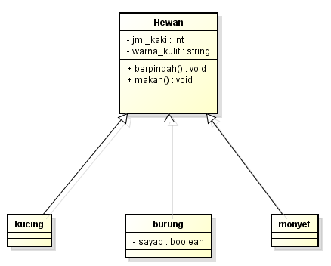
Inheritance
Simplify and reduce the redundancy of code

Slide 15
Inheritance
<?php
class hewan {
protected $jml_kaki;
protected $warna_kulit;
function __construct() {
}
function berpindah() {
echo "Saya pindah";
}
function makan() {
echo "Saya makan";
}
}
?>
<?php
class kucing extends hewan {
function berpindah() {
echo "Merangkak dengan 4 kaki";
}
}?>
<?php
class burung extends hewan {
protected $sayap;
function berpindah() {
echo "Saya terbang";
}
function makan() {
echo "Saya makan dengan mematuk";
}
}?>
<?php class monyet extends hewan { }?>

Slide 16
Calling Parent constructors
<?php
class SupClass{
private $prop1;
private $prop2;
function SupClass($prop1, $prop2)
{
$this->prop1 = $prop1;
$this->prop2 = $prop2;
}
function toString() {
return($this->prop1 .", ".$this->prop2);
}
}?>
<?php
class SubClass extends SupClass{
private $prop3;
function SubClass($prop1, $prop2, $prop3) {
SupClass::SupClass($prop1, $prop2);
$this->prop3 = $prop3;
}
function toString() {
return(SupClass::toString()." ".$this->prop3);
}
}
?>

Slide 17
Final Keyword
Final in class – class cannot be extended
Final in method – method cannot be overridden

Slide 18
Final Keyword
<?php
class BaseClass {
public function test() {
echo "BaseClass::test() called<br>";
}
final public function moreTesting() {
echo "BaseClass::moreTesting() called<br>";
}
}
class ChildClass extends BaseClass {
public function moreTesting() { //error
echo "ChildClass::moreTesting() called<br>";
}
}
?>
Fatal error: Cannot override final method BaseClass::moreTesting()

Slide 19
Final Keyword
<?php
final class BaseClass {
public function test() {
echo "BaseClass::test() called<br>";
}
public function moreTesting() {
echo "BaseClass::moreTesting() called<br>";
}
}
class ChildClass extends BaseClass {//error
public function moreTesting() {
echo "ChildClass::moreTesting() called<br>";
}
}
?>
Fatal error: Class ChildClass may not inherit from final class (BaseClass)

Slide 20
Abstract Class
Class that cannot be instantiated, only inherited.
Class that contains abstract method(s) must be declared abstract
declare an abstract class with the keyword abstract

Slide 21
Abstract Class
<?php
abstract class AbstractClass {
abstract protected function getValue();
abstract protected function prefixValue($prefix);
public function printOut() {
print $this->getValue() . "\n";
}
}
class ConcreteClass1 extends AbstractClass {
protected function getValue() {
return "ConcreteClass1";
}
public function prefixValue($prefix) {
return "{$prefix}ConcreteClass1";
}
}
?>

Slide 22
Interface
provide a common function names to the implementers
Define method(s) without detail specification
Methods in interface must be declared public
Use keyword implement to use an interface

Slide 23
Interface
Class cannot extends more than one class
Interface can be extended to other interface using extend keyword
Class that implement an interface must implement all the methods from the interface

Slide 24
Interface
<?php
interface a {
public function foo();
}
interface b extends a {
public function baz(Baz $baz);
}
?>
<?php
class c implements b {
public function foo() {
echo "foo";
}
public function baz(Baz $baz) {
echo "baz" . $baz;
}
}
?>

Slide 25
PHP and MVC
Model View Controller
Most common design pattern used in web application
Introduced by Smalltalk, adopted and popularized by Java
A lot of PHP framework using MVC design pattern

Slide 26
PHP and MVC
The model is responsible for organizing the data.
View tasked to display the data sent by the model in a specific format.
Controller handles layer model and the view to working together.

Slide 27
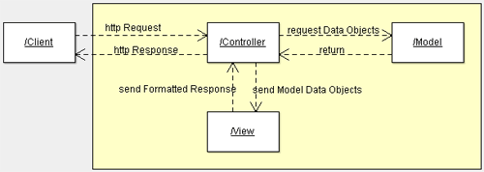
PHP andMVC

Slide 28
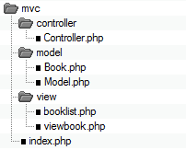
PHP and MVC

Slide 29
Model/Book.php
<?php
class Book {
public $title;
public $author;
public $description;
public function __construct($title, $author, $description)
{
$this->title = $title;
$this->author = $author;
$this->description = $description;
}
}
?>

Slide 30
Model/Model.php
<?php
include_once("model/Book.php");
class Model {
public function getBookList() {
return array(
"Jungle Book" =>
new Book("Jungle Book", "R. Kipling", "A classic book."),
"Moonwalker" =>
new Book("Moonwalker", "J. Walker", ""),
"PHP for Dummies" =>
new Book("PHP for Dummies", "Some Smart Guy", "")
);
}
public function getBook($title) {
$allBooks = $this->getBookList();
return $allBooks[$title];
}
}
?>

Slide 31
view/viewbook.php
<html>
<head></head>
<body>
<?php
echo 'Title:' . $book->title . '<br/>';
echo 'Author:' . $book->author . '<br/>';
echo 'Description:' . $book->description . '<br/>';
?>
</body>
</html>

Slide 32
view/booklist.php
<html>
<head></head>
<body>
<table>
<tbody>
<tr><td>Title</td><td>Author</td><td>Description</td></tr>
</tbody>
<?php
foreach ($books as $book) {
echo '<tr><td><a href="index.php?book=' .
$book->title . '">' . $book->title . '</a></td><td>' .
$book->author . '</td><td>' . $book->description .
'</td></tr>';
}
?>
</table>
</body>
</html>

Slide 33
controller/Controller.php
<?php
include_once("model/Model.php");
class Controller {
public $model;
public function __construct() {
$this->model = new Model();
}
public function invoke(){
if (!isset($_GET['book'])) {
$books = $this->model->getBookList();
include 'view/booklist.php';
}
else {
$book = $this->model->getBook($_GET['book']);
include 'view/viewbook.php';
}
}
}?>

Slide 34
index.php
<?php
include_once("controller/Controller.php");
$controller = new Controller();
$controller->invoke();
?>

Slide 35
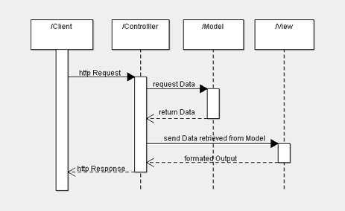
PHP and MVC

