Slide 1
Dasar Algoritma dan Pemrograman
First Meet
ADF

Slide 2
Course Introduction
Course Name: Dasar Algoritma dan Pemrograman
Course Code: KUG1C3
Credits : 3
14 weeks
3 SKS -> 3 hours/week
1 credit lab work

Slide 3
Contact Person
Anditya Arifianto
NIP: 14891268-1
HP: 085295464439
Email:
anditya.arifianto@gmail.com
Can be found at
AI Lab

Slide 4
Our Rules
Any kind of Cheating and Plagiarism is not acceptable
Be responsible with your attendance
What about language?
Mind your manner
Activity is a point

Slide 5
Points
Mid Exam
Final Exam
Assignment + Quiz
Project

Slide 6
Points
A | 80 … 100.0
AB | 75 … 79.99
B | 70 … 74.99
BC | 60 … 69.99
C | 50 … 59.99
D | 40 … 49.99
E | 0 ... 39.99

Slide 7
Lab work Points
A | 85 … 100.0
AB | 80 … 84.99
B | 70 … 79.99
BC | 60 … 69.99
C | 50 … 59.99
D | 40 … 49.99
E | 0 ... 39.99

Slide 8
Cheating Punishment
Proven cheating during practicum
First time : downgrade final score, module score = 0
Second time : final score = E
Cheating during final test
Final score = E
We will post the names on the bulletin board

Slide 9
A little time to know you guys
Please answer honestly and independently
Write down your nickname, student number, and class
Write the name of your High School
Write down your score from Calculus I
Draw a 2D shape
Explain briefly, what are you going to do if your PC suddenly shut down

Slide 10
Roots of Computer Science
Computer
science
Mathematics
Engineering
Analysis
Design
Notes:
The root of computer science extends deeply into Mathematics and Engineering
Mathematics impacts in analysis
While engineering impacts on design

Slide 11
Branches of Computer Science
Computer Architecture
Software Systems
Theory of
Computation
Artificial
Intelligence
Algorithms
Computer
science
Notes:
Here are the main branches of CS

Slide 12
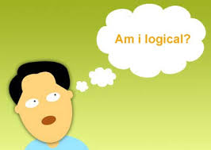
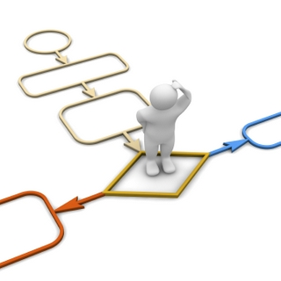
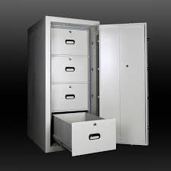
Outline Course
How to Write a Code
Logic and
Programming
Function and
Procedure
Variable
Loop
Condition
Array

Slide 13
Question?

Slide 14
Programming and logic is depend on how often you practice

Slide 15
The point is to understand

Slide 16
Learn to Code

